Slide 1
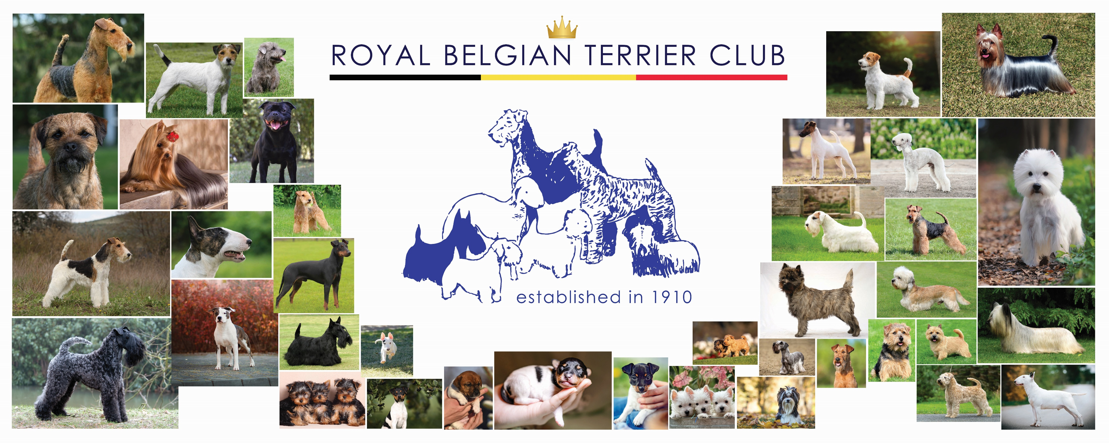
Presentation Terriers
FCI breeds 3 - nomenclature

Slide 2
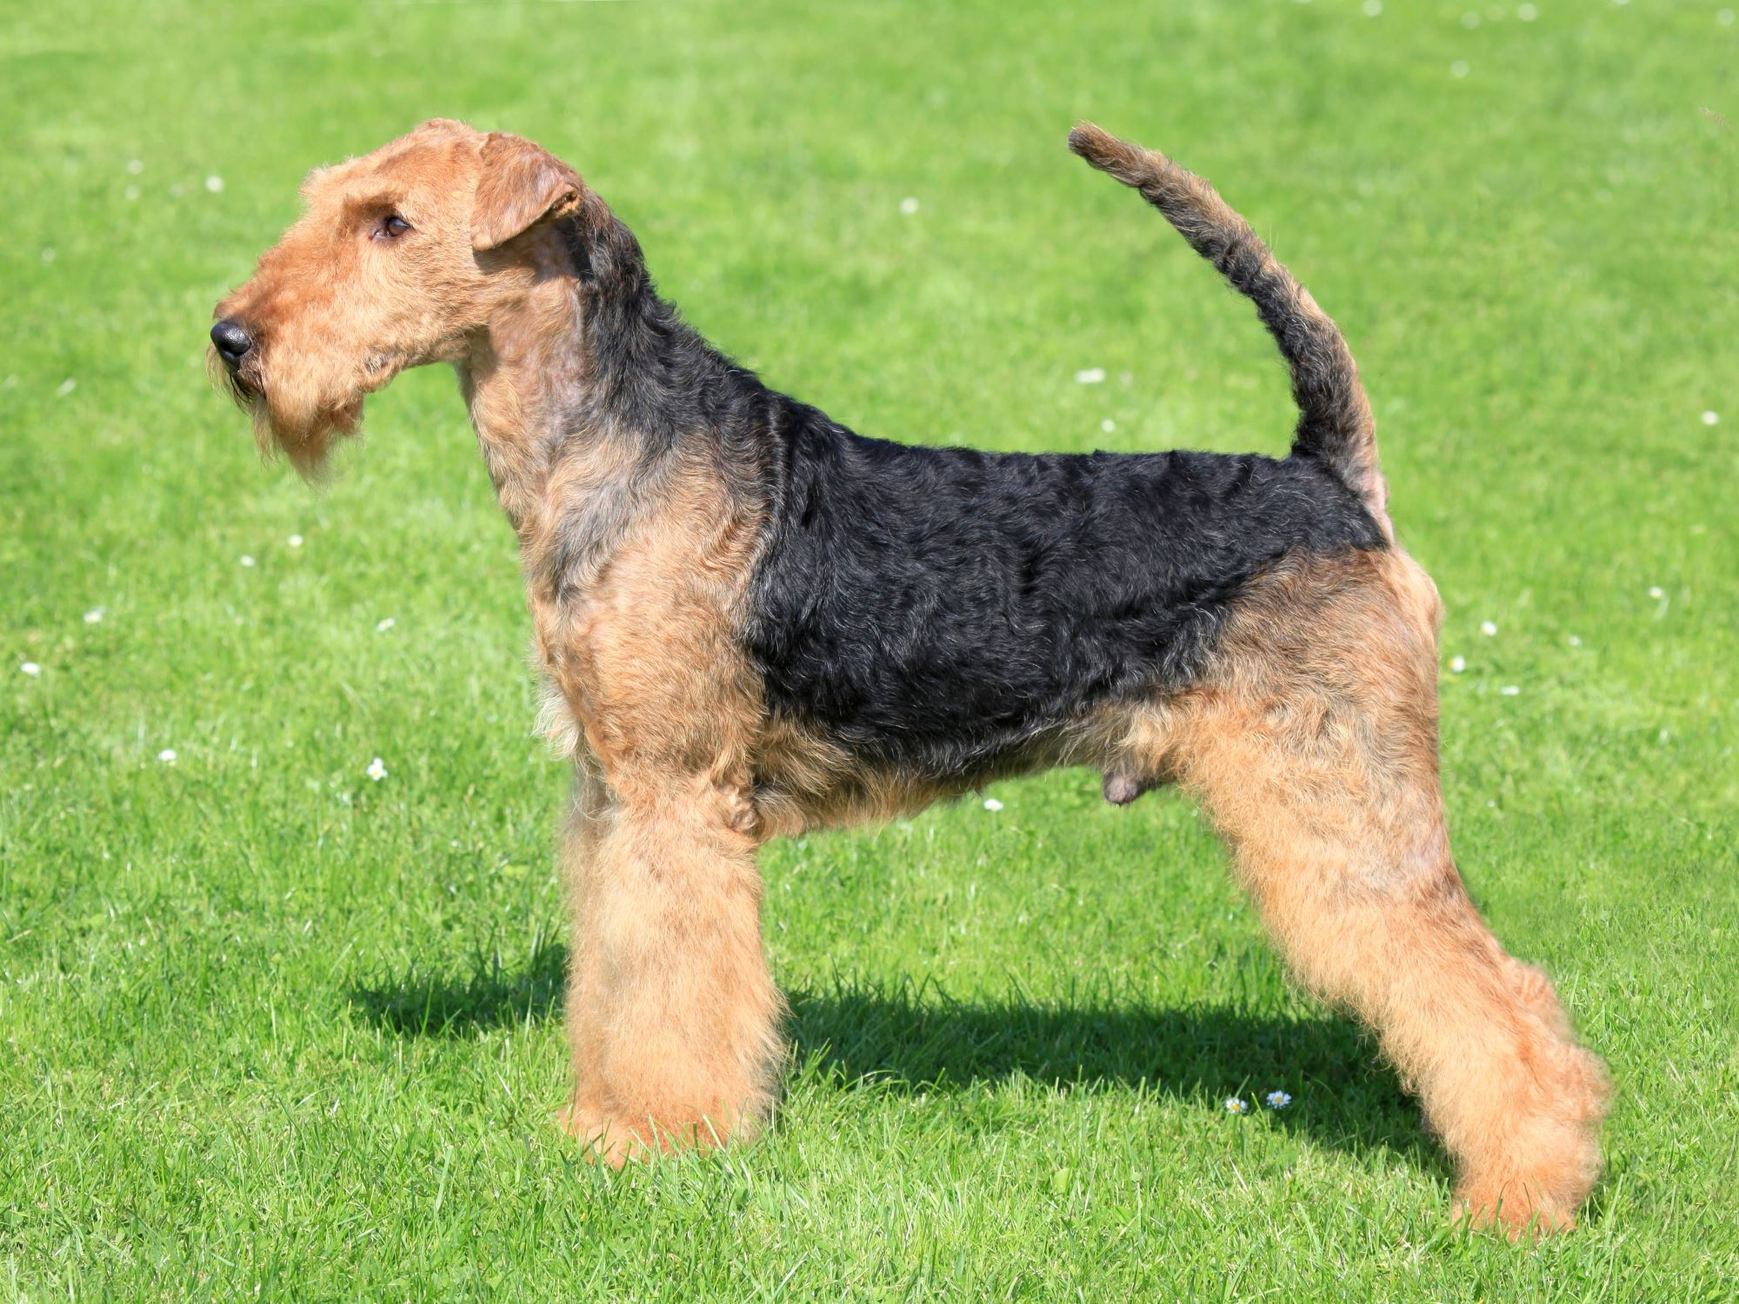
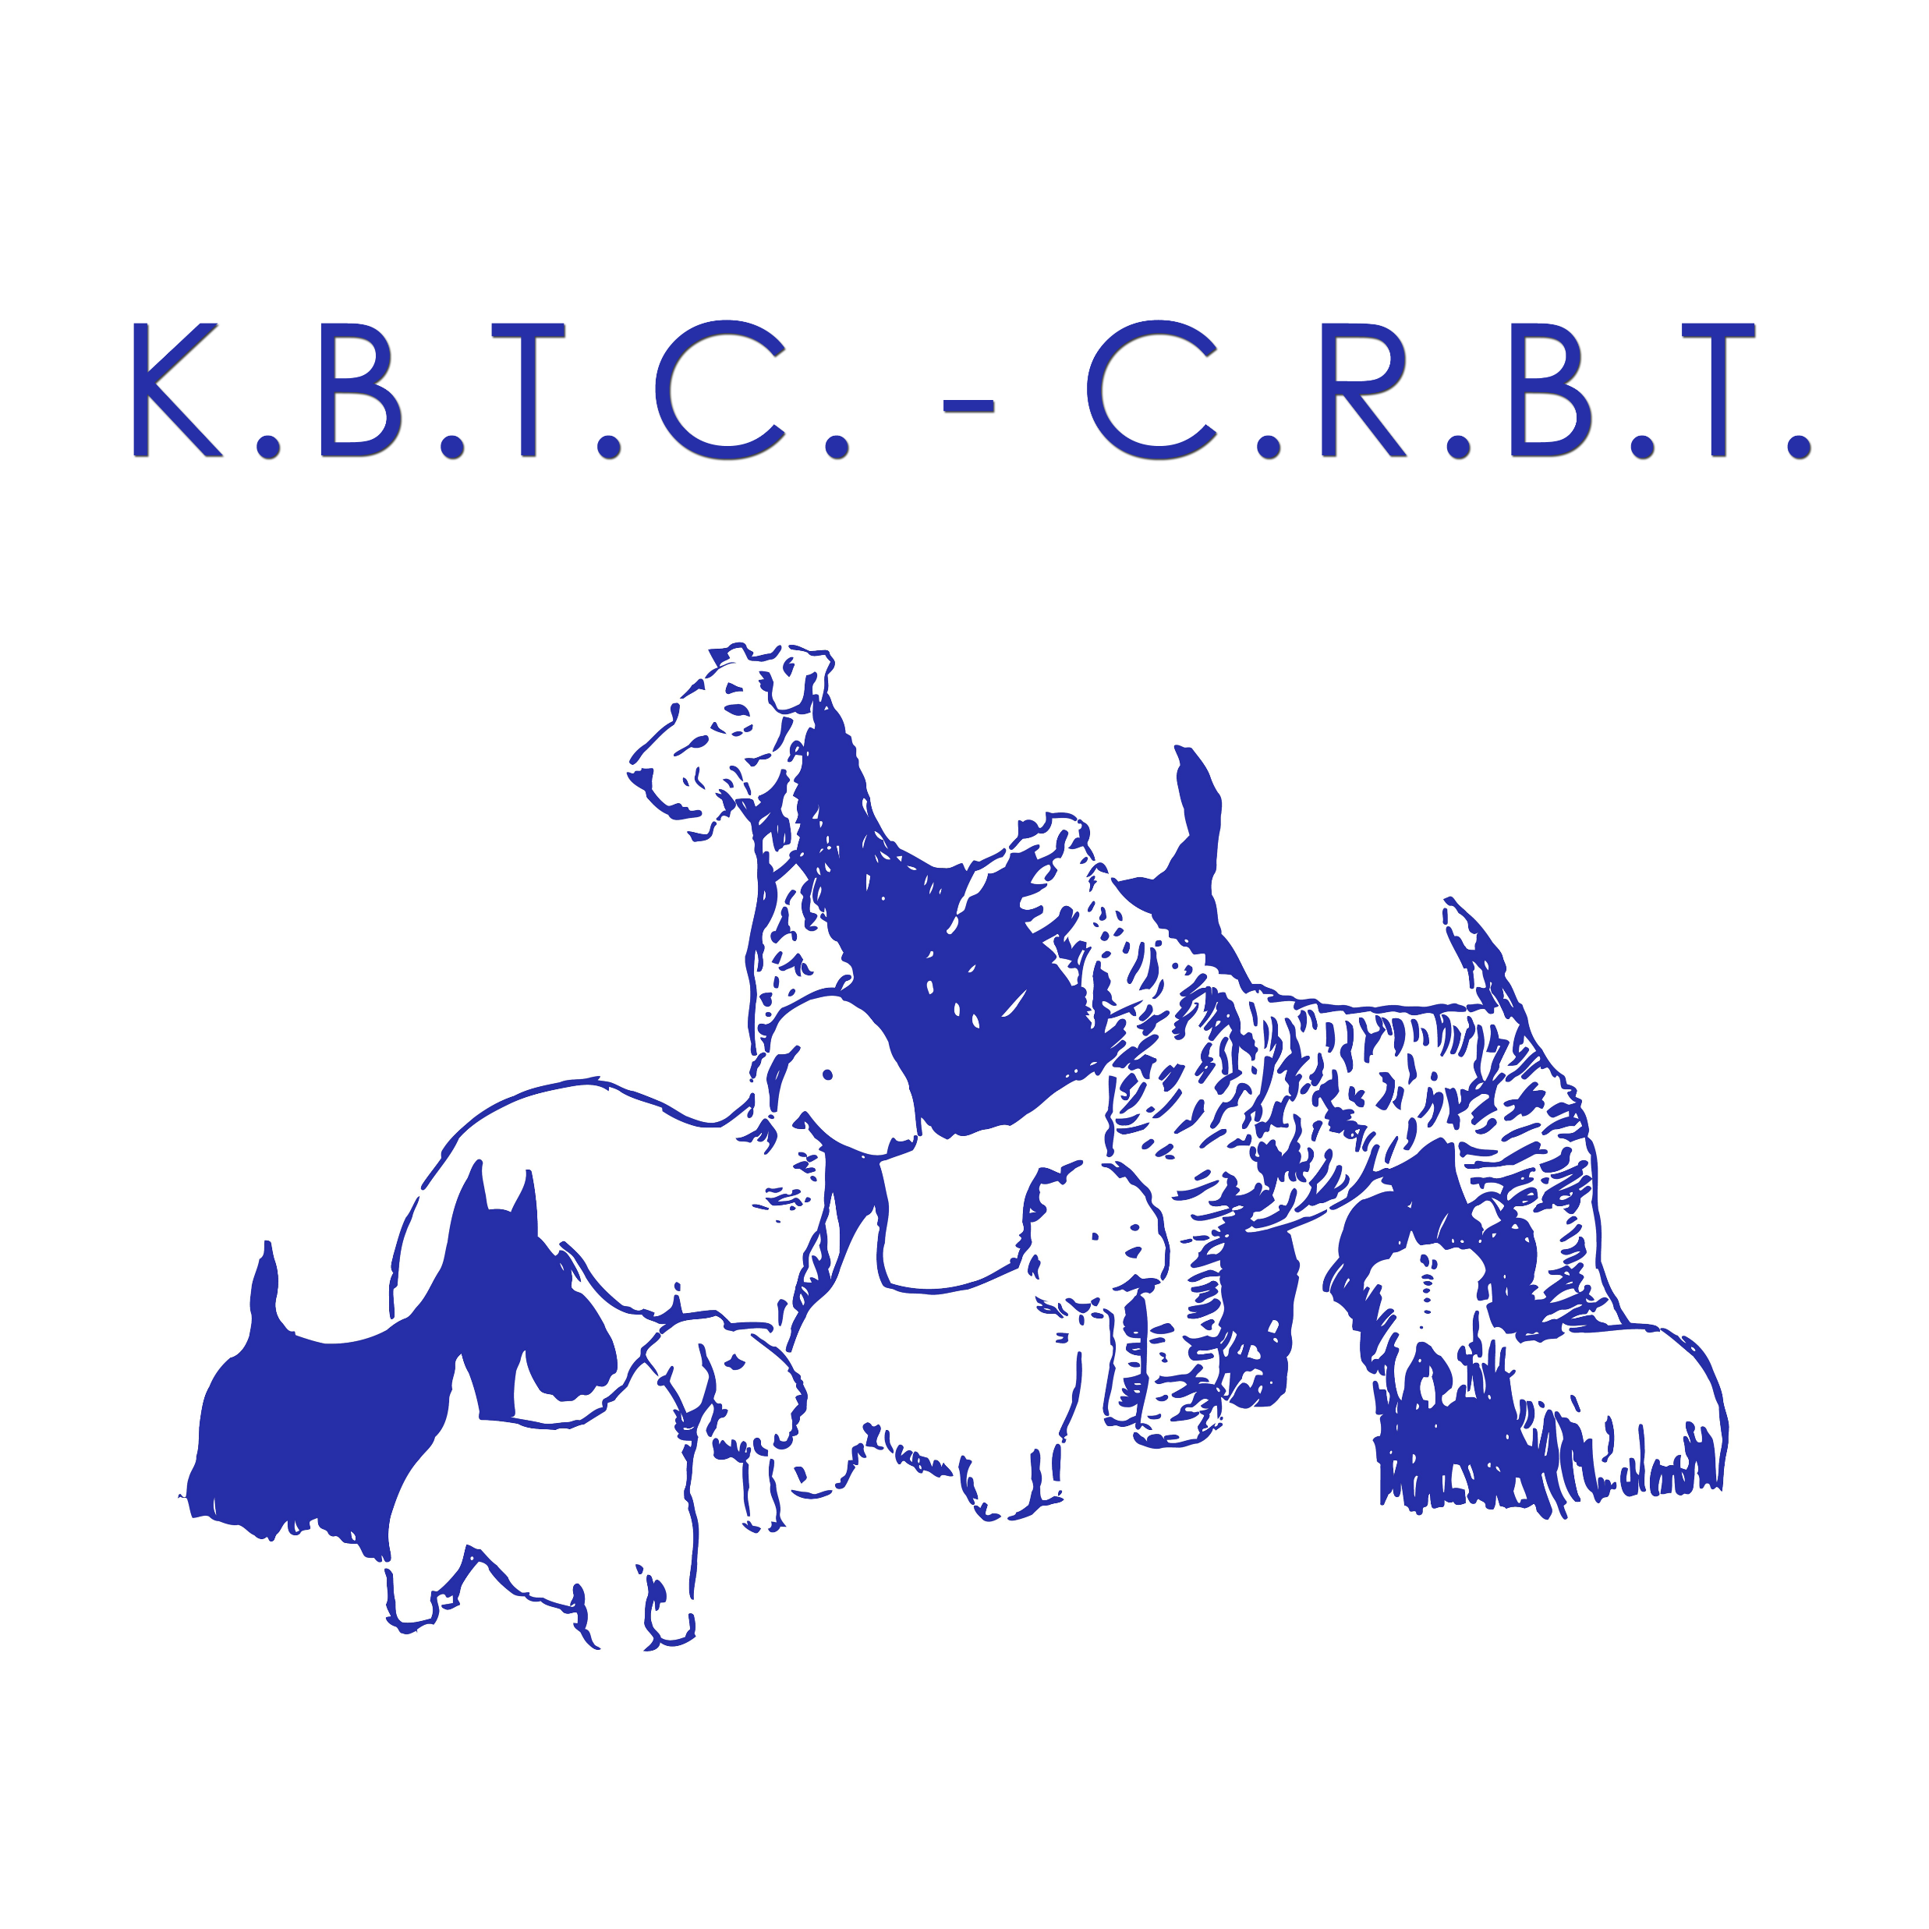
AIREDALE TERRIER
Measures | Ideal
Height at the withers | Males 58 - 61cm, females 56 - 59cm
Weight
Standards | FCI – 007
Coat | Hard, dense and wiry, not so long as to appear ragged.
Colour | Body saddle black or grizzle as is top of the neck and top surface of tail. All other parts tan.
Country of origin: GREAT BRITAIN
Largest of the Terriers, a muscular, active, fairly cobby dog, without suspicion of legginess or undue length of body.
Keen of expression, quick of movement, on the tiptoe of expectation at any movement.
Character denoted and shown by expression of eyes, and by carriage of ears and erect tail. Outgoing and confident, friendly, courageous, and intelligent. Alert at all times, not aggressive but fearless.

Slide 3
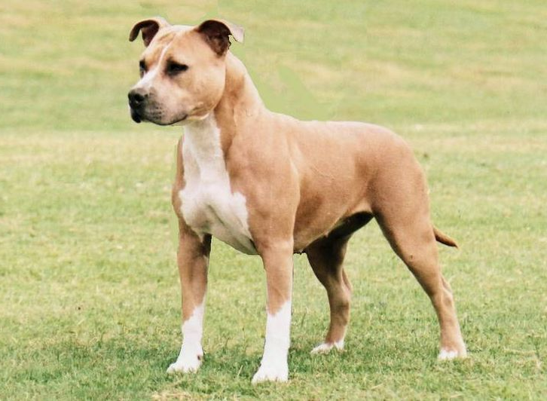
AMERICAN STAFFORDSHIRE TERRIER
Measures | Ideal
Height at the withers | Male 64-48cm, female 43-46cm
Weight
Standards | FCI – 286
Coat | Short, close, stiff to the touch, glossy.
Colour | Any colour, solid, particolour, or patched is permissible; but more than 80% white
Country of origin: U.S.A.
The Staffordshire Terrier should give the impression of great strength for his size; a well put together dog, muscular, but agile and graceful, keenly alive to his surroundings. He
should be stocky, not long-legged or racy in outline. His courage is proverbial.

Slide 4
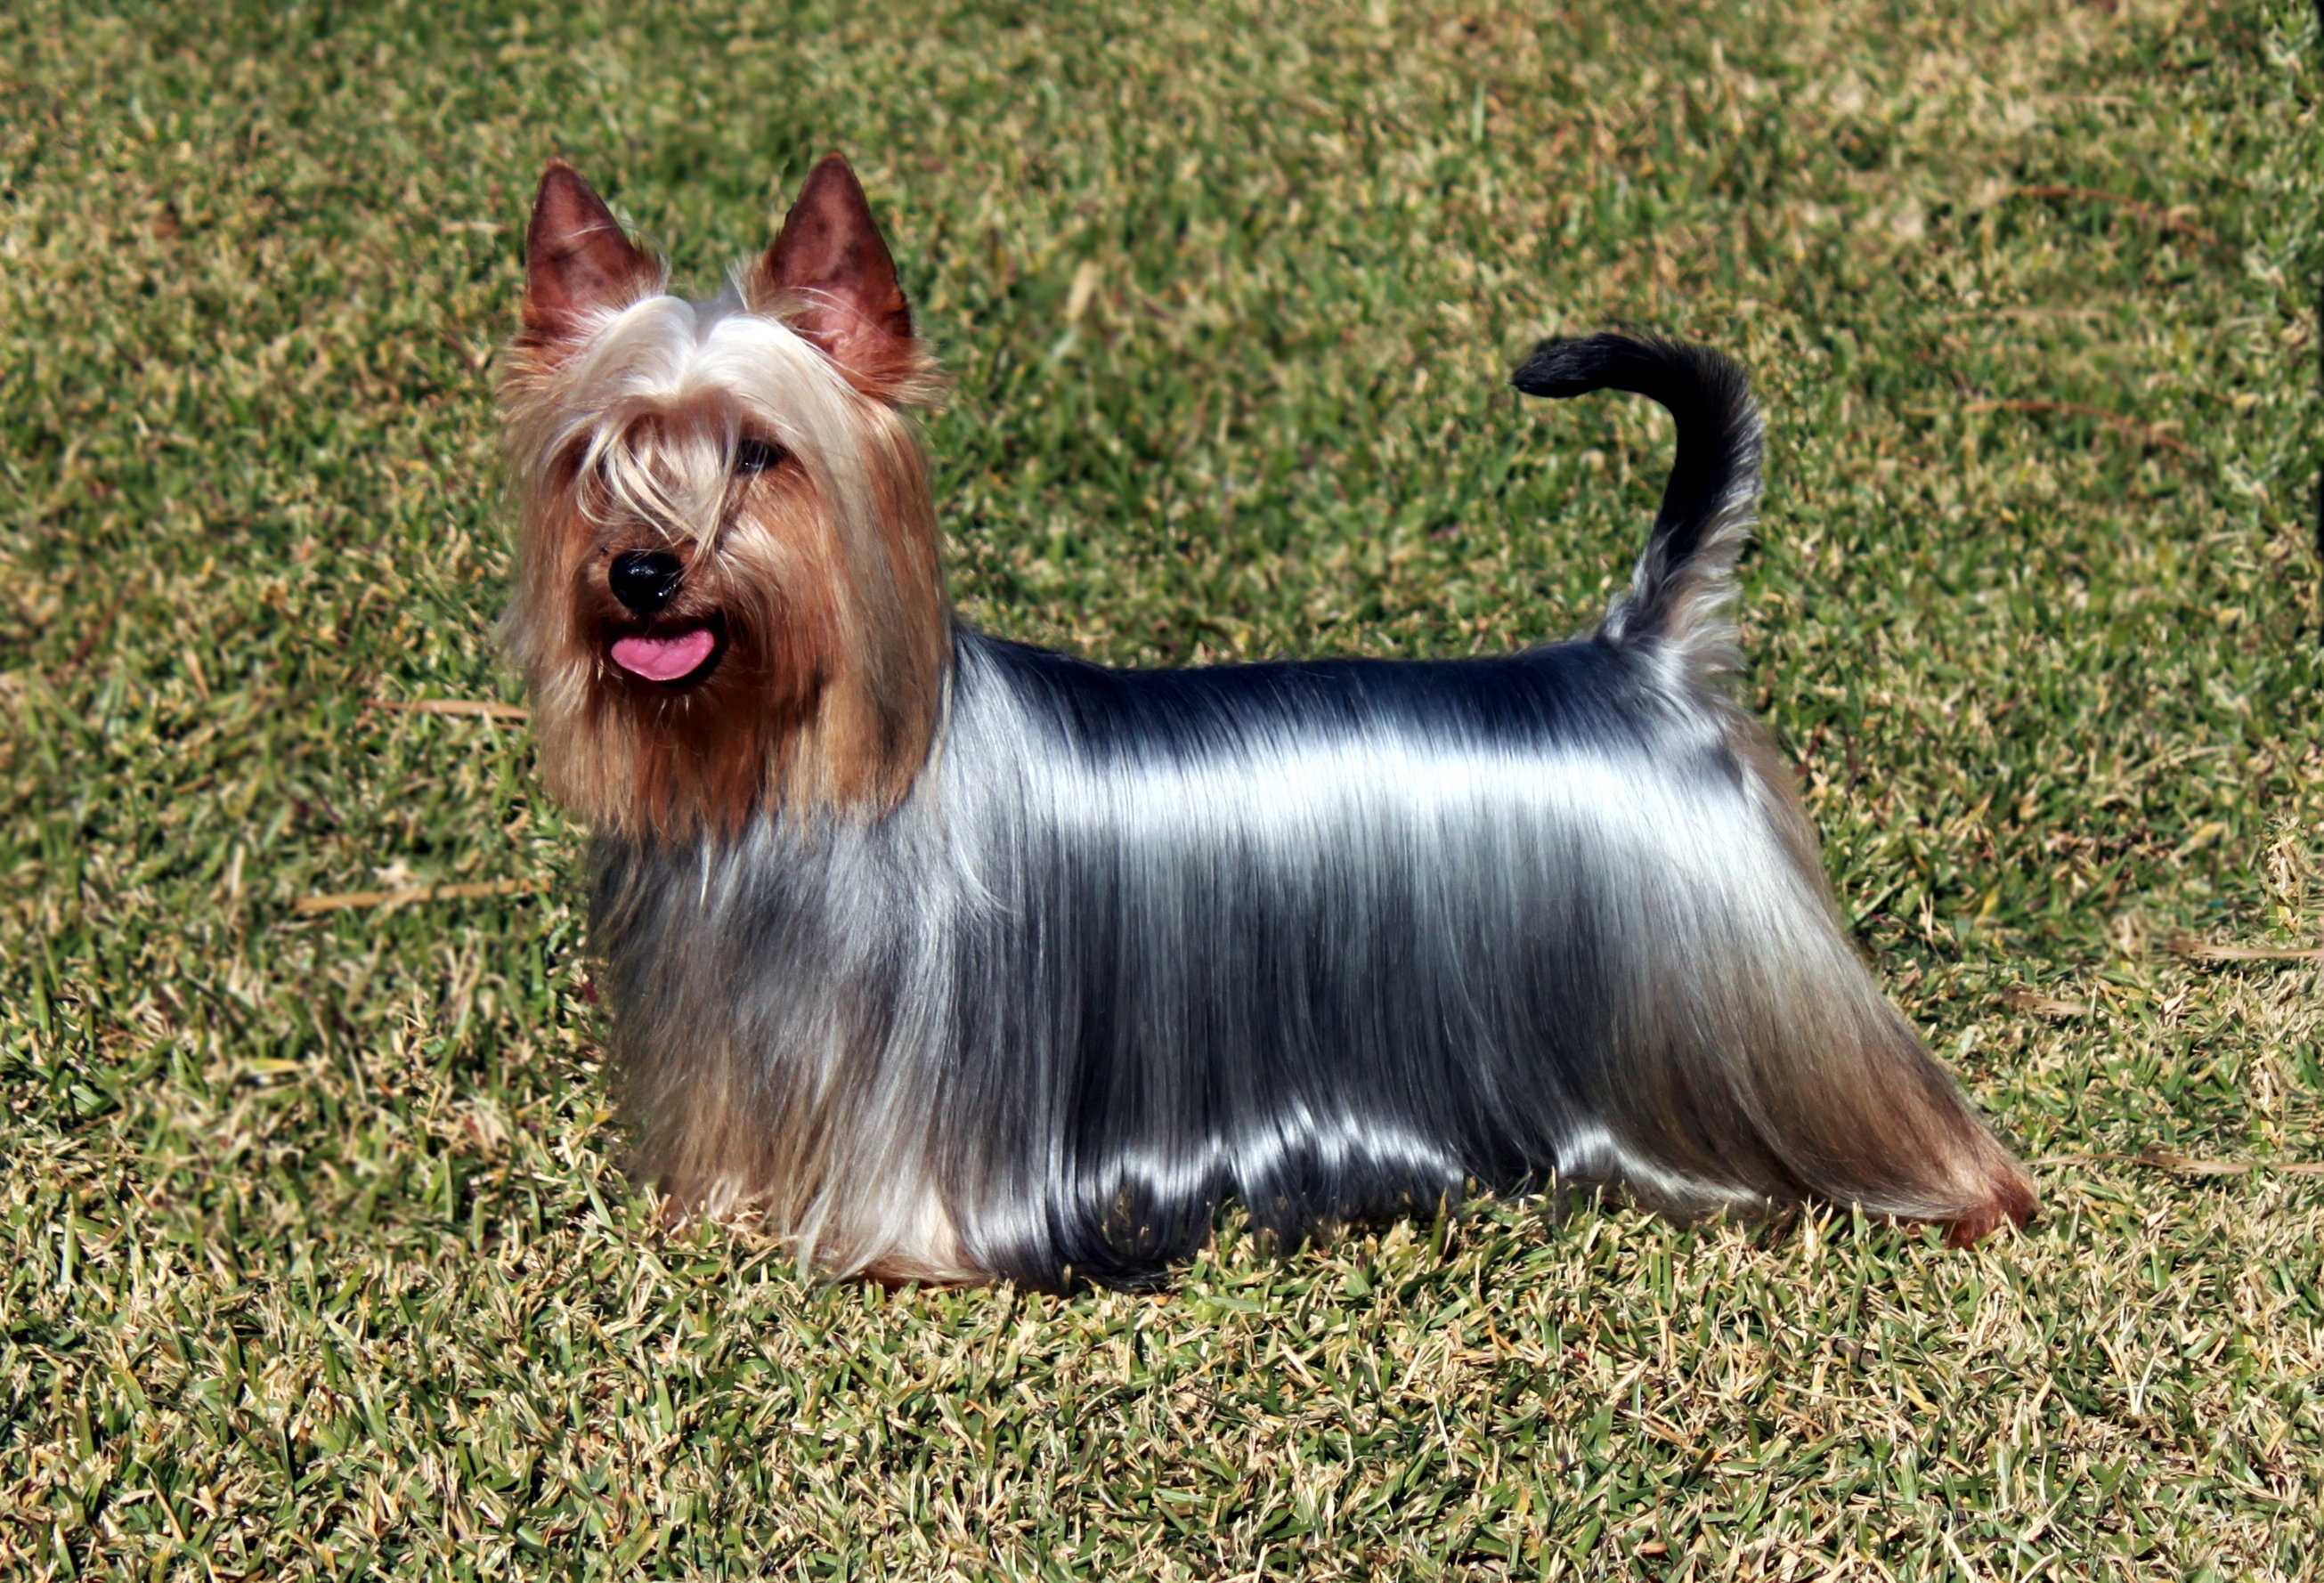
AUSTRALIAN SILKY TERRIER
Measures | Ideal
Height at the withers | Male 23-26cm, female can be slightly less
Weight | weight in proportion to height
Standards | FCI – 236
Coat | Must be flat, fine and glossy and of a silky texture.
Colour | All shades of blue and tan are acceptable, the richer these colours and more clearly defined the better.
Country of origin: AUSTRALIA
The dog is compact, moderately low set, of medium length with a refined structure but of sufficient substance to suggest the ability to hunt and kill domestic rodents. The parted, straight silky hair presents a well-groomed appearance.
It should display Terrier characteristics, embodying keen alertness, activity and soundness. A courageous and dignified Toyterrier, that is second to none as a companion.

Slide 5
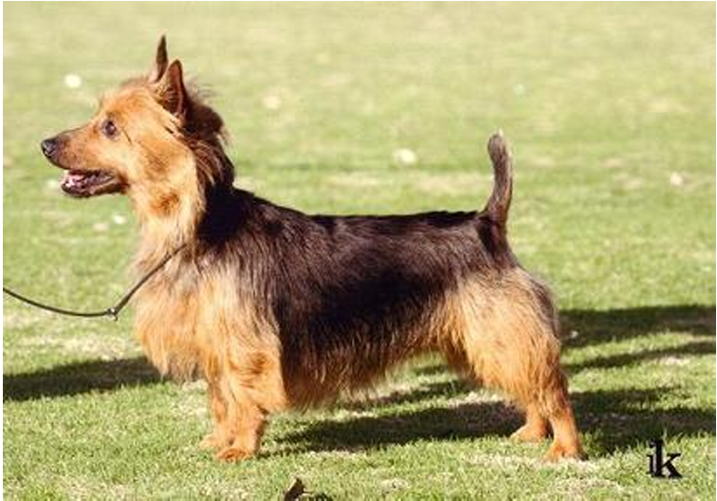
AUSTRALIAN TERRIER
Measures | Ideal
Height at the withers | approx. 25cm, females slightly less
Weight | approx. 6,5kg, females slightly less
Standards | FCI – 008
Coat | body coat consists of a harsh straight dense top coat approx. 6cm long with short soft textured undercoat.
Colour | Blue, steel blue or dark grey blue, with rich tan (not sandy) on face, ears, under body, lower legs and feet
Country of origin: AUSTRALIA
A sturdy low-set dog, rather long in proportion to height with strong Terrier character, alertness, activity and soundness.
Essentially a working terrier, but its loyalty and even disposition make it equally suitable as a companion dog.

Slide 6
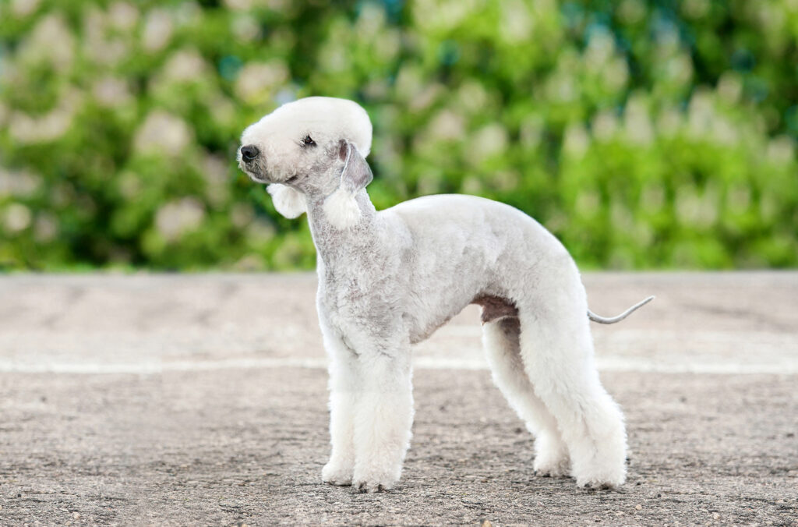
BEDLINGTON TERRIER
Measures | Ideal
Height at the withers | About 41cm
Weight | Between 8 -10 kg
Standards | FCI – 009
Coat | Very distinctive. Thick and linty, standing well out from skin, but not wiry.
Colour | Blue, liver, or sandy with or without tan.
Country of origin: GREAT BRITAIN
A graceful, lithe, muscular dog, with no signs of either weakness or coarseness. Whole head pear or wedge-shaped, and expression in repose mild and gentle.
Spirited and game, full of confidence. An intelligent companion with strong sporting instincts. Good-tempered, having an affectionate nature, dignified, not shy or
nervous. Mild in repose but full of courage when roused.

Slide 7
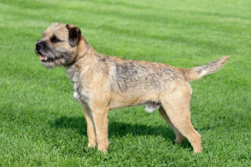
BORDER TERRIER
Measures | Ideal
Height at the withers | Male 5,9-7,1 kg, female 5,1-6,4 kg.
Weight
Standards | FCI – 010
Coat | Harsh and dense; with close undercoat.
Colour | Red, wheaten, grizzle and tan, or blue and tan.
Country of origin: GREAT BRITAIN
Essentially a working terrier. Capable of following a horse.
Combining activity with gameness.

Slide 8
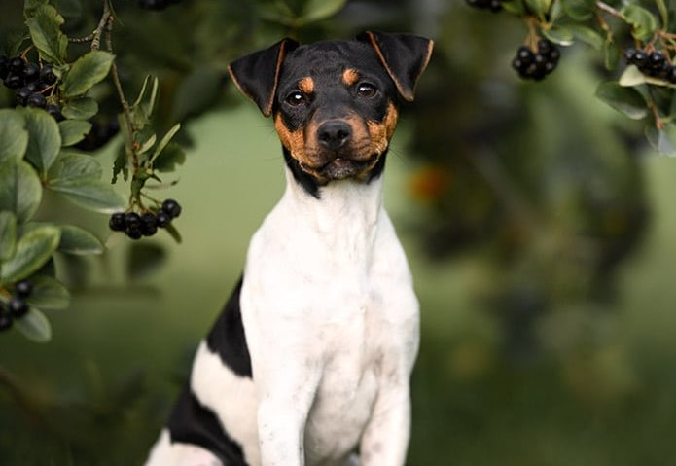
BRAZILIAN TERRIER
Measures | Ideal
Height at the withers | Males 35-40cm, females 33-38 cm
Weight | Approximately 10 kg
Standards | FCI – 341
Coat | Short, smooth, fine but not soft, laid close to the skin.
Colour | Ground colour predominant white with black, blue, brown or isabella markings
Country of origin: BRAZIL
Medium-sized dog, slender, well balanced, with firm but not very heavy structure, square shaped body with curved lines.
Restless, alert, active and keen; friendly and gentle to friends, suspicious of strangers.

Slide 9
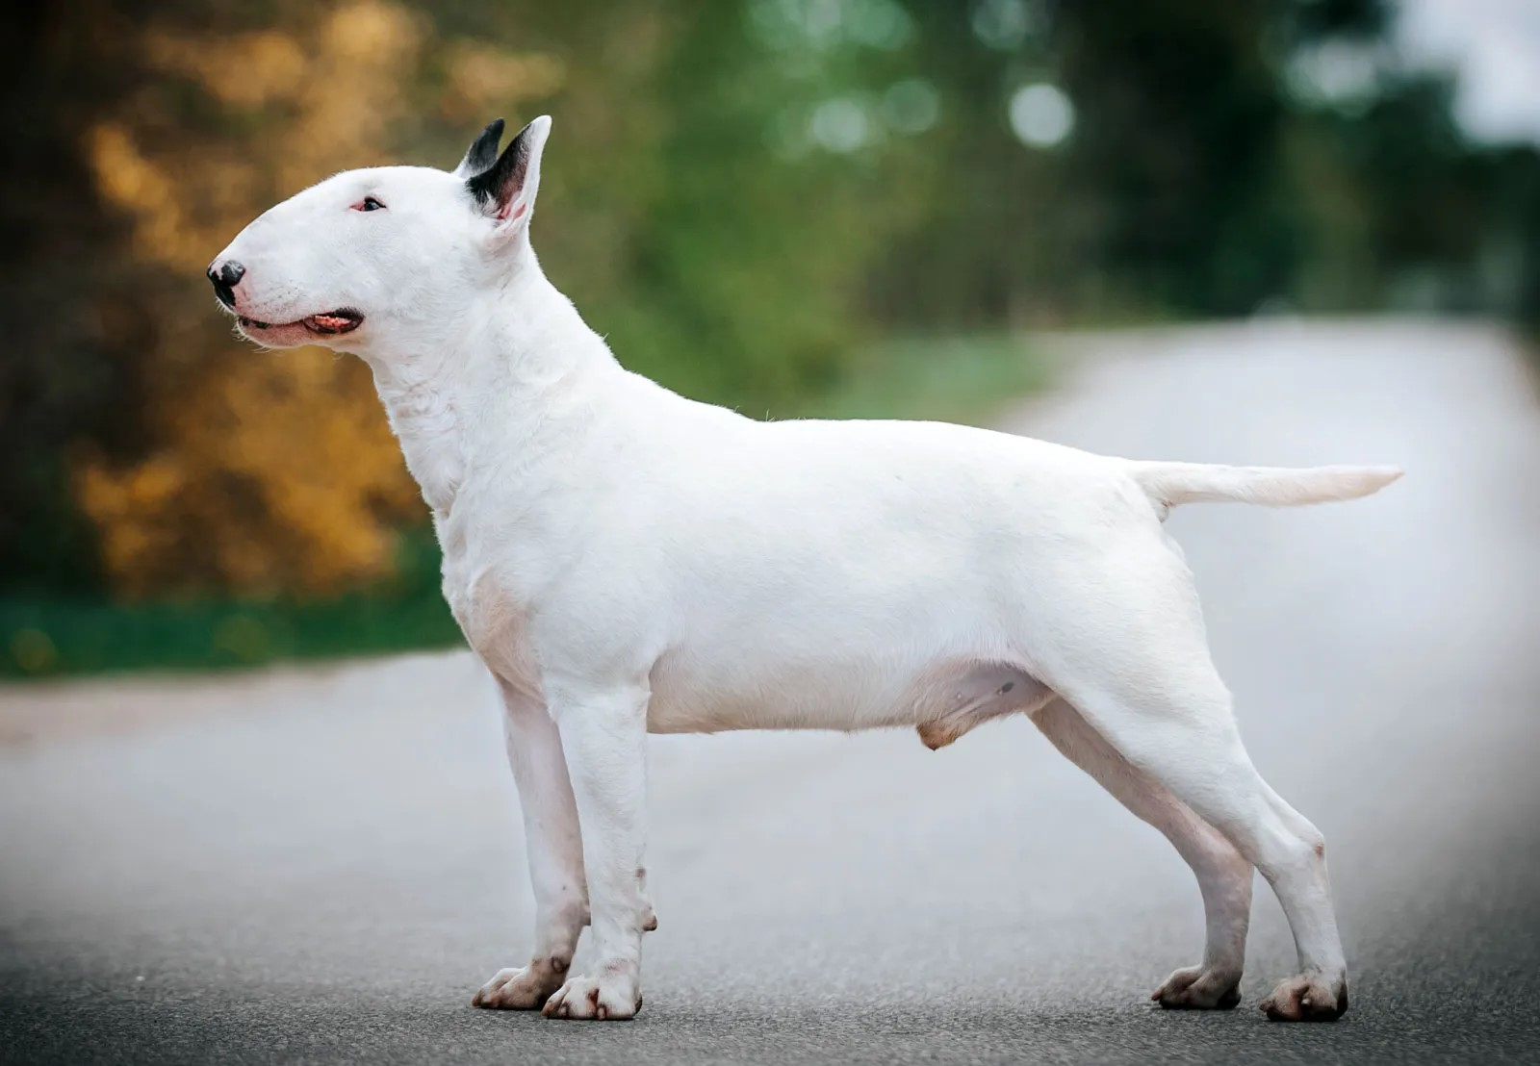
BULL TERRIER
Measures | Ideal
There are neither weight nor height limits | but there should be the impression of maximum substance for size of dog consistent with quality and sex.
Weight
Standards | FCI – 011
Coat | Short, flat, even and harsh to touch with a fine gloss.
Colour | For white, pure white coat. For coloured, colour predominates; Black brindle, red, fawn and tricolour.
Country of origin: GREAT BRITAIN
Strongly built, muscular, well balanced and active with a keen, determined and intelligent expression. A unique feature is a downfaced, egg-shaped head.
Irrespective of size dogs should look masculine and bitches feminine.
Courageous, full of spirit, with a fun-loving attitude. Of even temperament and amenable to discipline. Although obstinate is particularly good with people.

Slide 10
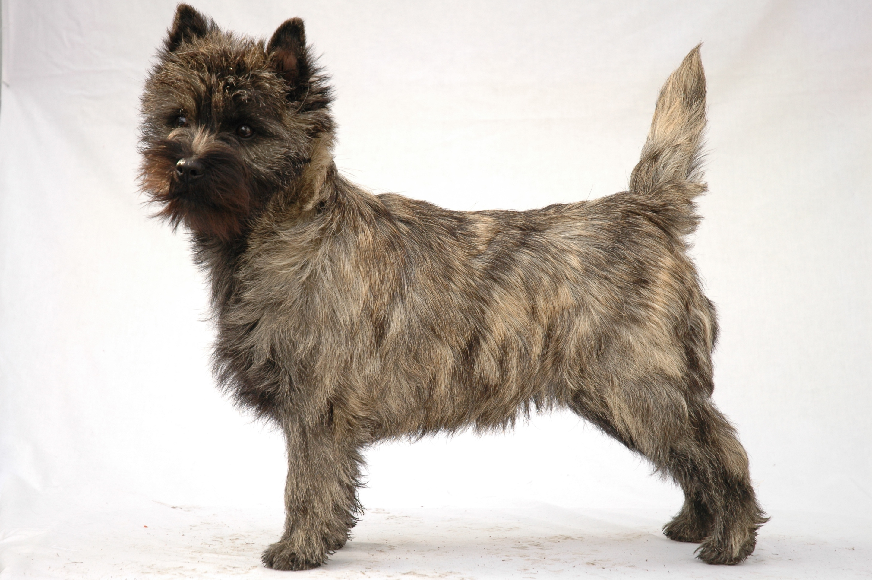
CAIRN TERRIER
Measures | Ideal
Height at the withers | Approximately 28-31 cm
Weight | In proportion, ideally 6-7,5 kg
Standards | FCI – 004
Coat | Very important. Weather-resistant. Must be double-coated, with profuse, harsh, but not coarse, outer coat
Colour | Cream, wheaten, red, grey or nearly black.
Country of origin: GREAT BRITAIN
Agile, alert, of workmanlike, natural appearance. Standing well forward on forepaws. Strong quarters. Deep in rib, very free in movement.
Should impress as being active, game and hardy. Fearless and gay disposition; assertive but not aggressive.

Slide 11
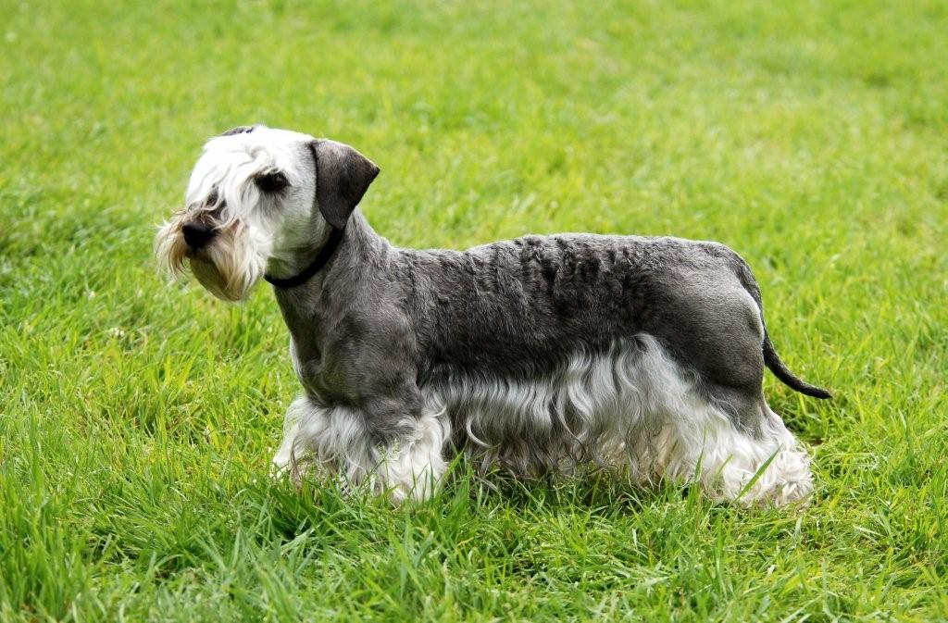
CESKY TERRIER
Measures | Ideal
Height at the withers | Male 29 cm, female 27 cm
Weight | Between 6 and 10 kg
Standards | FCI – 246
Coat | Hair long, fine but firm, slightly wavy with a silky gloss
Colour | 2 varieties: grey-blue or light-coffee-brown
Country of origin: CZECH REPUBLIC
Short legged, long haired, well made and well muscled Terrier with smallish drop ears, of a rectangular format.
Balanced, non-aggressive, pleasant and cheerful companion, easy to train; somewhat reserved towards strangers; of calm and kind disposition.

Slide 12
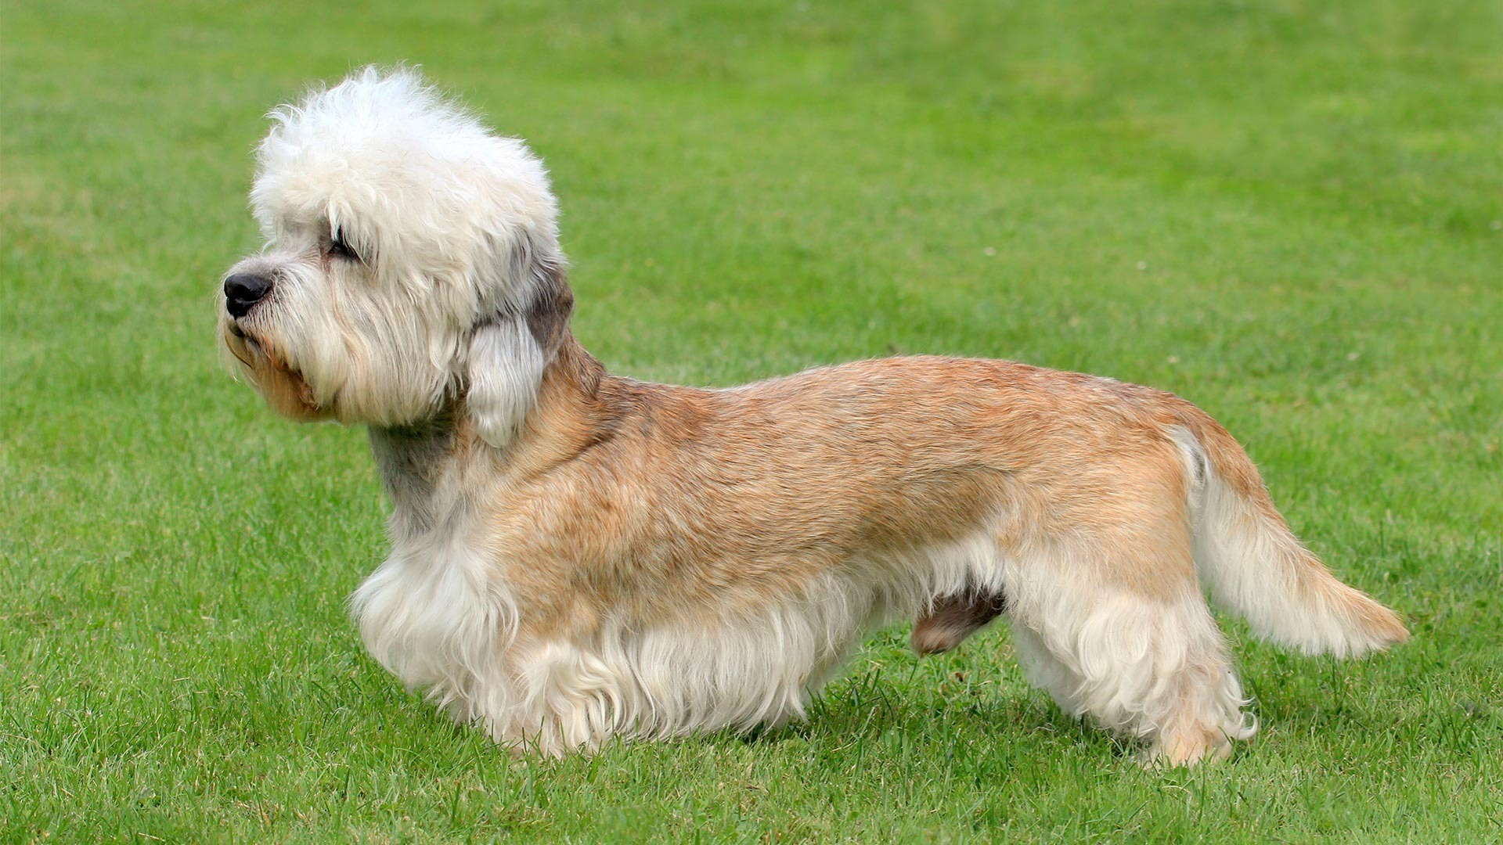
DANDIE DINMONT TERRIER
Measures | Ideal
Height at the withers
Weight | Between 8 and 11 kg
Standards | FCI – 168
Coat | Double coat with a soft linty undercoat and a harder topcoat
Colour | Pepper (silver grey-black) or mustard (reddish brown–pale fawn)
Country of origin: GREAT BRITAIN
Distinctive head with beautiful silky covering, with large, wise intelligent eyes offsetting long, low weaselly body. Short, strong legs; weatherproof coat.
Game, workmanlike Terrier. Independent, highly intelligent, determined, persistent,
sensitive, affectionate and dignified.

Slide 13
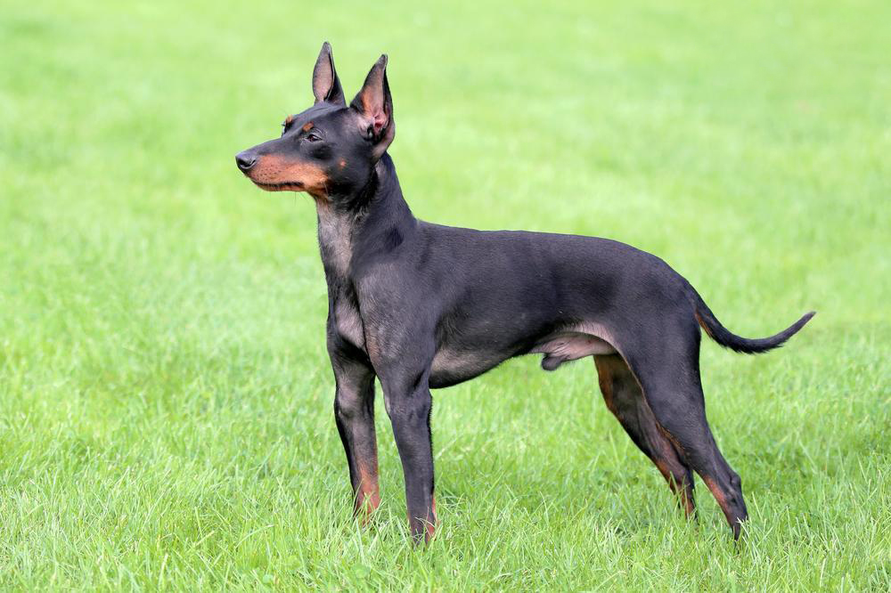
ENGLISH TOY TERRIER BLACK (B&T)
Measures | Ideal
Height at the withers | Between 25 and 30 cm
Weight | Between 2,7 and 3,6 kg
Standards | FCI – 013
Coat | Thick, close and glossy. A density of short hair required.
Colour | Black and tan. The black ebony, the tan likened to a new chestnut deeply rich.
Country of origin: GREAT BRITAIN
Well balanced, elegant and compact, sleek and cleanly built. Head and legs proportionate thus producing the correct balance.
Toy with Terrier characteristics. Alert, remembering that historically he could acquit
himself satisfactorily in the rat pit. Never unduly nervous.

Slide 14
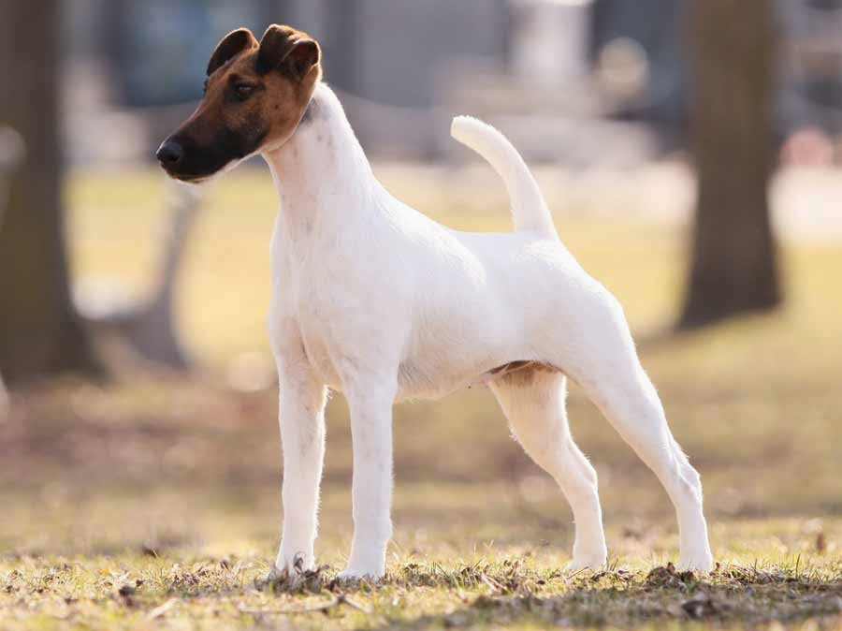
FOX TERRIER SMOOTH
Measures | Ideal
Height at the withers | Not exceeding 39cm, females slightly less
Weight | Males 7,5-8 kg, females 7-7,5 kg
Standards | FCI – 012
Coat | Straight, flat, smooth, hard, dense and abundant.
Colour | White should predominate, all white, white with tan, black and tan or black markings.
Country of origin: GREAT BRITAIN
Active and lively, bone and strength in small compass, never cloddy or coarse. Neither leggy nor too short in the leg, standing like a well made, short-backed hunter, covering a lot of ground.
Alert, quick of movement, keen of expression, on tiptoe of expectation. Friendly, forthcoming and fearless.

Slide 15
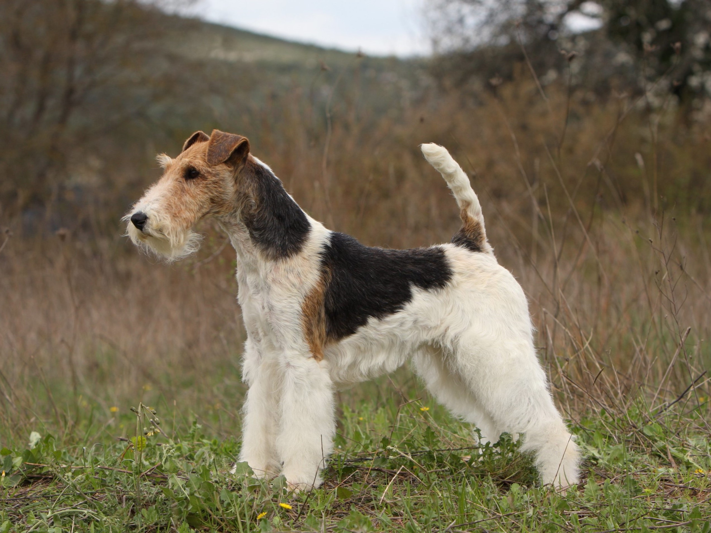
FOX TERRIER WIRE
Measures | Ideal
Height at the withers | Not exceeding 39cm, females slightly less
Weight | Ideally 8,25 kg, females slightly less
Standards | FCI – 169
Coat | Dense, wiry texture, 2 cm on shoulder to 4 cm on withers, back, ribs and quarters with undercoat of short, softer hair.
Colour | White predominates with black, black and tan or tan markings.
Country of origin: GREAT BRITAIN
Active and lively, bone and strength in small compass, never cloddy or coarse. Standing like a short-backed hunter covering a lot of ground.
Alert, quick of movement, keen of expression, on tiptoe of expectation at slightest provocation. Friendly, forthcoming and fearless.

Slide 16
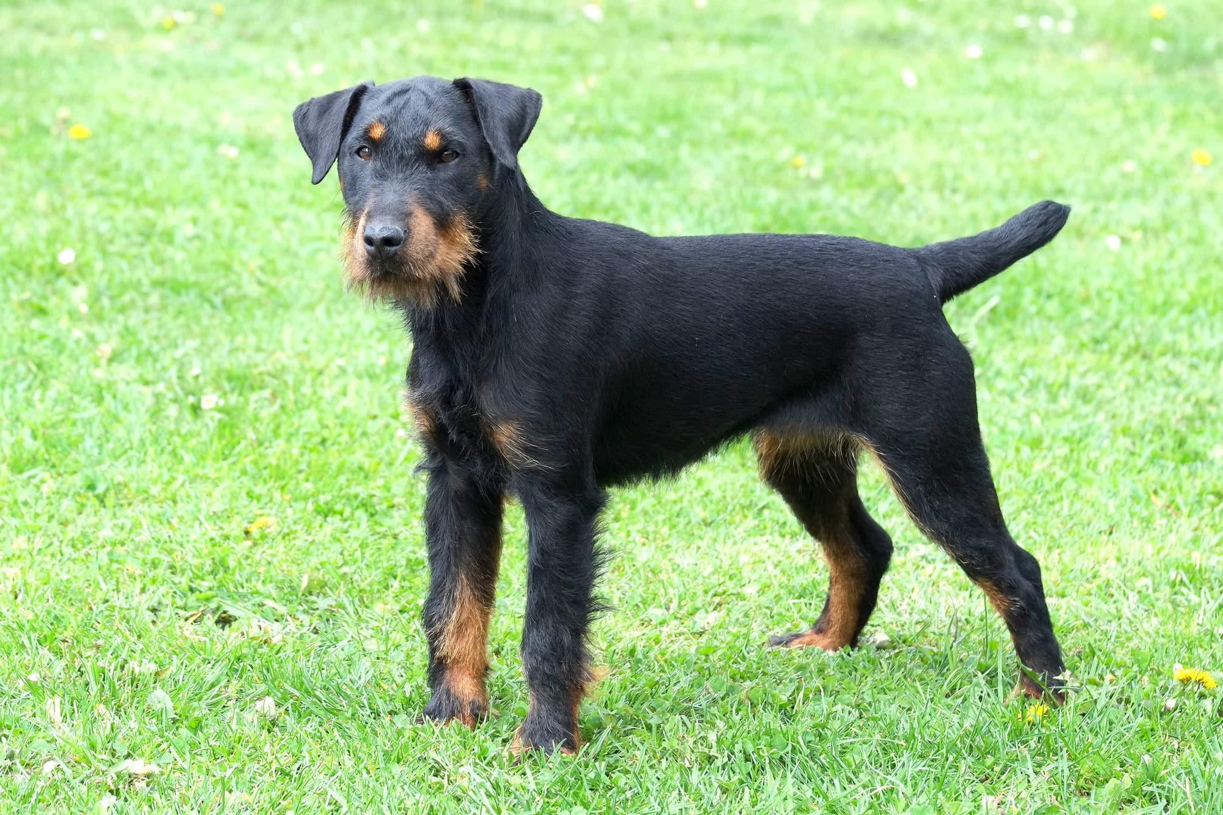
GERMAN HUNTING TERRIER
Measures | Ideal
Height at the withers | Males 33 - 40 cm, females 33 - 40 cm.
Weight according to build | not too light nor too heavy
Standards | FCI – 103
Coat | Plain, dense; hard rough hair or coarse smooth hair.
Colour | The colour is black, dark-brown or greyish-black, with yellow-red clearly defined markings
Country of origin: GERMANY
A smallish, generally black and tan, compact, well proportioned working hunting dog.
Courageous and hard, takes pleasure in work, enduring, vital, full of temperament, reliable, sociable and trainable, neither shy nor aggressive.

Slide 17
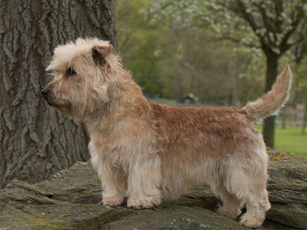
IRISH GLEN OF IMAAL TERRIER
Measures | Ideal
Height at the withers | Males max 35,5cm, females accord. less
Weight | Males max 16kg, females accordingly less
Standards | FCI – 302
Coat | Medium length, of harsh texture with soft undercoat. Coat may be tidied to present a neat outline.
Colour | Blue brindle; Wheaten, from light to golden reddish shade
Country of origin: IRELAND
Great strength with the impression of maximum substance for the size of the dog.
Active, agile and silent when working. Game and spirited with great courage when called upon, otherwise gentle and docile, who oozes personality; his loyal and affectionate nature makes him a very acceptable house dog and companion. Less easily excited than other terriers, though he is always ready to give chase when called on.

Slide 18
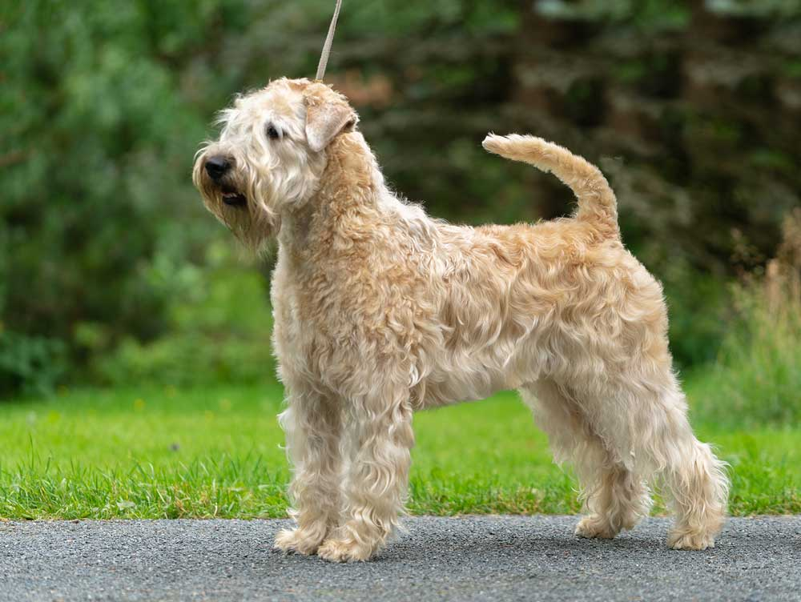
IRISH SOFT COATED WHEATEN TERRIER
Measures | Ideal
Height at the withers | Males max 46-48cm, females some less
Weight | Males max 18-20,5kg, females some less
Standards | FCI – 040
Coat | A single coated dog. Texture soft and silky to feel and not harsh.
Colour | from light wheaten to a golden reddish hue
Country of origin: IRELAND
A hardy, active, short coupled dog, well built, giving the idea of strength. Not too leggy nor too low to the ground.
Spirited and game. Good tempered. Most affectionate and loyal to his owners. Most
intelligent. A trusty, faithful friend, defensive without aggression.

Slide 19
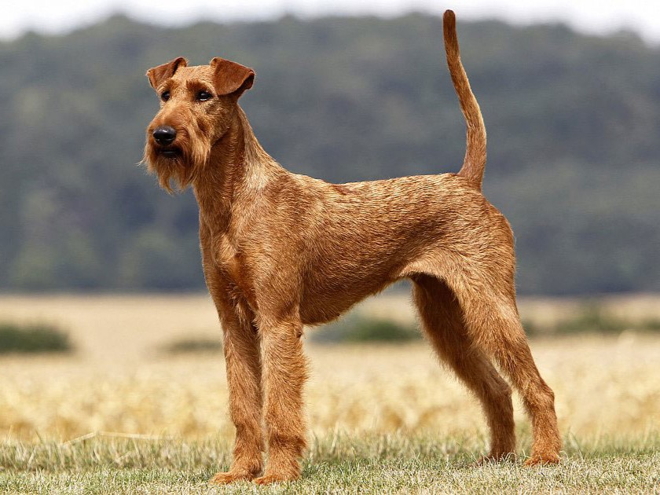
IRISH TERRIER
Measures | Ideal
Height at the withers | Approximately 45,5 cm
Weight | Between 11 and 12 kg
Standards | FCI – 139
Coat | Should be dense and wiry in texture, having a broken appearance but still lying flat
Colour | whole coloured being red, red-wheaten or yellow-red.
Country of origin: IRELAND
The dog must present an active, lively, lithe and wiry appearance; lots of substance, at the same time free of clumsiness, as speed and endurance as well as power is very
essential.
While being game and capable of holding his own with other dogs, is remarkably
loyal, good tempered and affectionate with mankind,

Slide 20
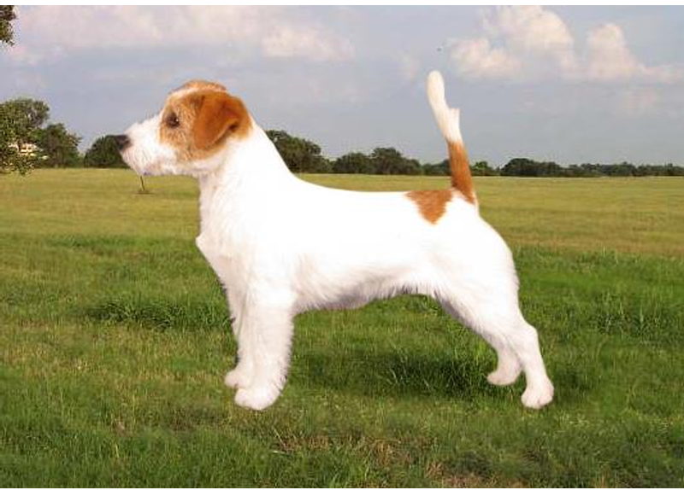
JACK RUSSELL TERRIER
Measures | Ideal
Height at the withers | Between 25 and 30 cm
Weight | 1kg every 5cm height (eg. 30cm = 6kg)
Standards | FCI - 345
Coat | May be smooth, broken or rough coated
Colour | White must predominate with black and/or tan markings
Country of origin: GREAT BRITAIN
A strong, active, lithe working Terrier of great character with flexible body of medium length. His smart movement matches his keen expression.
A lively, alert and active Terrier with a keen, intelligent expression. Bold and fearless, friendly but quietly confident.

Slide 21
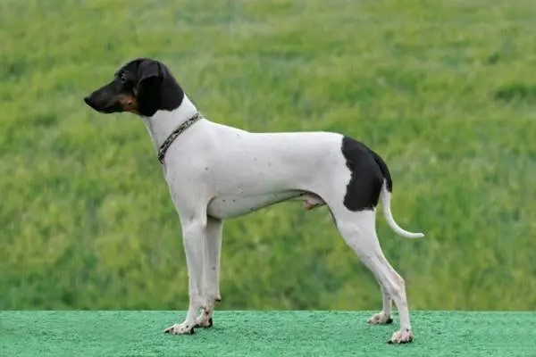
JAPANESE TERRIER (Nihon Teria)
Measures | Ideal
Height at the withers | Male / female both between 30 – 33 cm
Weight
Standards | FCI – 259
Coat | Short, smooth, dense and glossy.
Colour | Tricolour with black, tan and white head; white with black spots, black markings or tan markings on body
Country of origin: JAPAN
Small-sized dog of smart appearance with a clear-cut and compact outline. The coat is very short, being about 2 mm in length.
The Japanese Terrier is swift and lively in temperament.

Slide 22
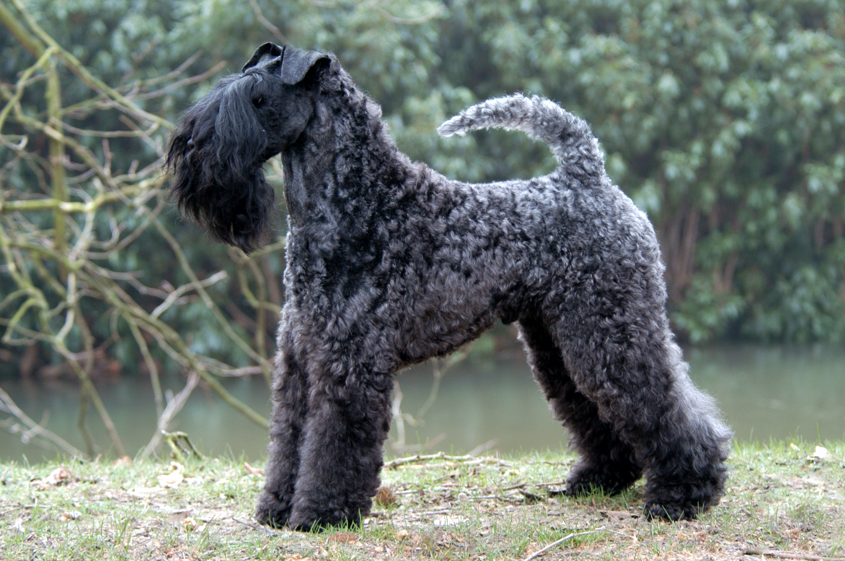
KERRY BLUE TERRIER
Measures | Ideal
Height at the withers | Male 45,5 – 49,5 cm, female 44,5 – 48 cm
Weight | Male 15 -18 kg, female proportionally less
Standards | FCI – 003
Coat | Soft, plentiful, and wavy
Colour | Blue of any shade with or without black points. Black is permissible only up to the age of 18 months
Country of origin: IRELAND
The typical Kerry Blue Terrier should be upstanding, well-knit and well proportionated, showing well developed muscular body with definite terrier style.
Terrier character throughout. The all-important factor-expression must be keen and alert.

Slide 23
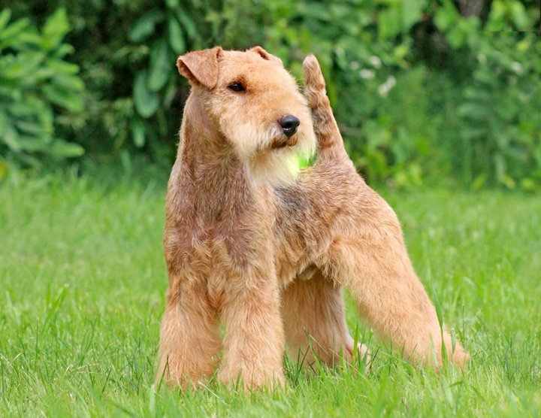
LAKELAND TERRIER
Measures | Ideal
Height at the withers | Not exceeding 37 cm at shoulder
Weight | Male 7,7 kg; female 6,8 kg
Standards | FCI – 070
Coat | Dense, harsh and weather resisting with good undercoat
Colour | Black and tan, blue and tan, red, wheaten, red grizzle, liver, blue or black
Country of origin: GREAT BRITAIN
Smart, workmanlike, well balanced and compact.
Gay, fearless demeanour, keen of expression, quick of movement, on the tip-toe of expectation. Bold, friendly and self-confident

Slide 24
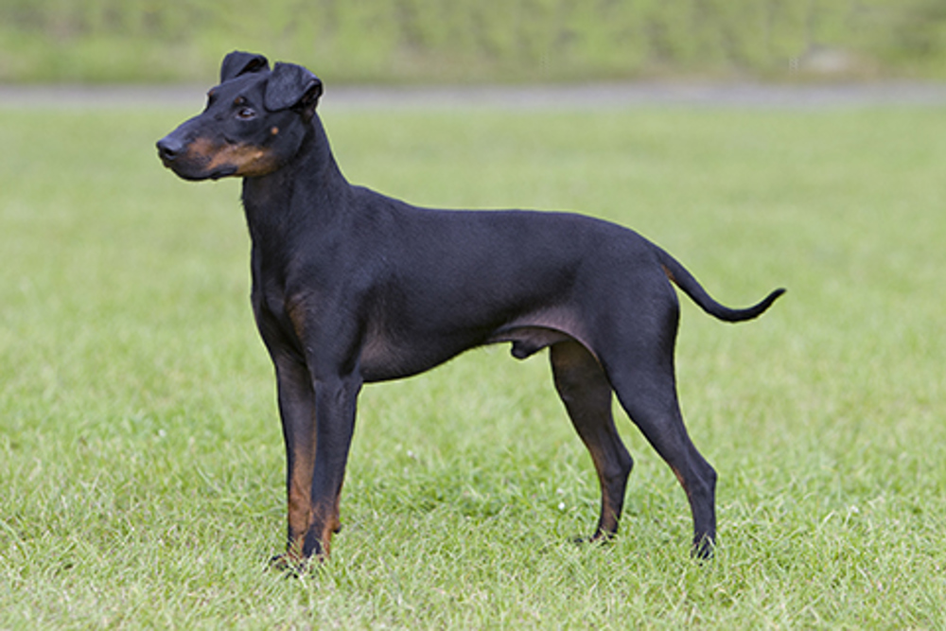
MANCHESTER TERRIER
Measures | Ideal
Height at the withers | Males: 41 cm. Females : 38 cm
Weight
Standards | FCI – 071
Coat | Close, smooth, short and glossy, of firm texture
Colour | Jet black and rich mahogany tan distributed
Country of origin: GREAT BRITAIN
Compact, elegant and sound with substance.
Keen, alert, gay and sporting; discerning and devoted.

Slide 25
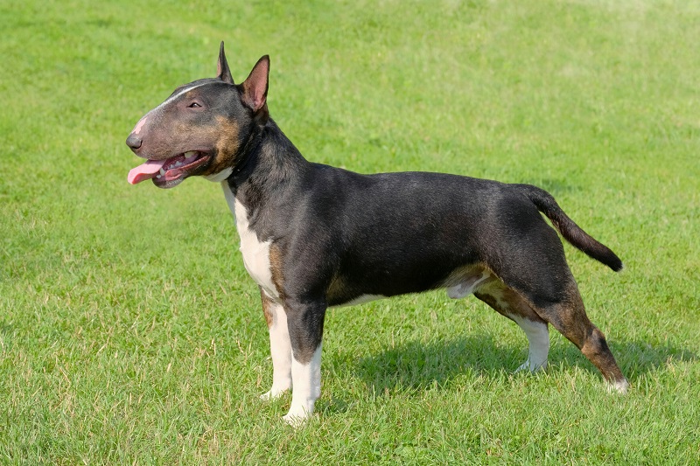
MINIATURE BULL TERRIER
Measures | Ideal
Height at the withers
Weight
Standards | FCI – 359
Coat | Short, flat, even and harsh to touch with a fine gloss.
Colour | For white, pure white coat. For coloured, colour predominates
Country of origin: GREAT BRITAIN
Strongly built, muscular, well balanced and active with a keen, determined and intelligent expression. A unique feature is a downfaced, egg-shaped head. Irrespective of size dogs should look masculine and bitches feminine.
Courageous, full of spirit, with a fun-loving attitude. Of even temperament and amenable to discipline. Although obstinate is particularly good with people.

Slide 26
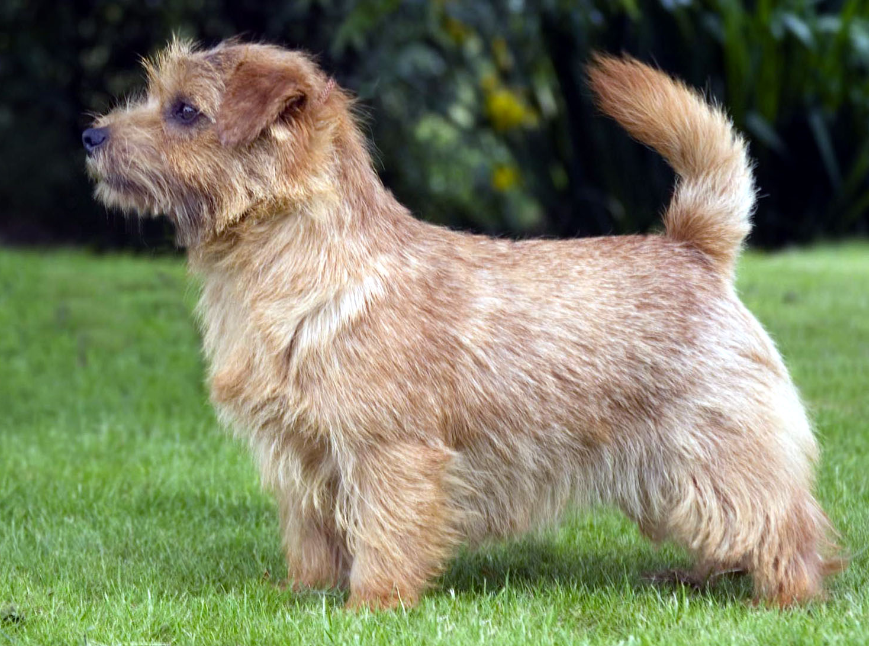
NORFOLK TERRIER
Measures | Ideal
Height at the withers | 25 cm
Weight
Standards | FCI – 272
Coat | Hard, wiry, straight, lying close to body. Longer and rougher on neck and shoulders.
Colour | All shades of red, wheaten, black and tan or grizzle.
Country of origin: GREAT BRITAIN
One of the smallest of terriers. Low, keen dog, compact and strong, short back, good substance and bone.
A “demon” for its size. Lovable disposition, not quarrelsome, hardy constitution; alert and fearless.

Slide 27
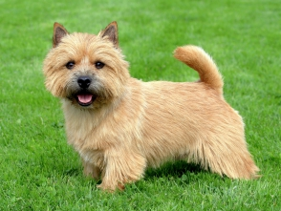
NORWICH TERRIER
Measures | Ideal
Height at the withers | 25 cm
Weight
Standards | FCI – 072
Coat | Hard, wiry, straight, lying close to body, thick undercoat.
Colour | All shades of red, wheaten, black and tan or grizzle.
Country of origin: GREAT BRITAIN
One of the smallest of the terriers. Low, keen dog, compact and strong with good substance and bone.
Lovable disposition, not quarrelsome, tremendously active with hardy constitution.
Gay and fearless.

Slide 28
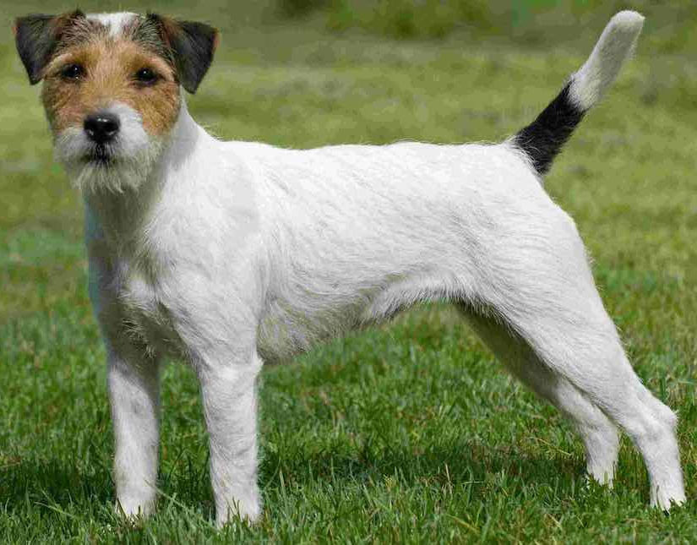
PARSON RUSSELL TERRIER
Measures | Ideal
Height at the withers | Males: 36 cm; Female: 33 cm
Weight
Standards | FCI – 339
Coat | Whether rough, broken or smooth naturally harsh, flat, straight, close and dense with good undercoat.
Colour | White or predominantly white with tan, lemon or black markings
Country of origin: GREAT BRITAIN
Workmanlike, active and agile, without exaggeration. Built for stamina and endurance, overall picture of balance and flexibility.
Originally a terrier bred to work fox, a confident, energetic and happy dog that has the ability and conformation to go to ground. Bold and friendly.

Slide 29
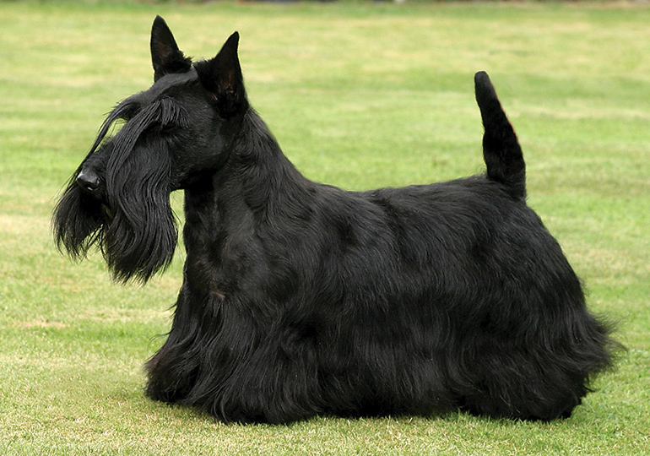
SCOTTISH TERRIER
Measures | Ideal
Height at the withers | Between 25 and 28 cm
Weight | Between 8,5 and 10,5 kg
Standards | FCI – 073
Coat | Close-lying, double coat; undercoat short, dense and soft; outer coat harsh, dense and wiry
Colour | Black, wheaten or brindle of any shade
Country of origin: GREAT BRITAIN
Thick-set, of suitable size to go to ground, short-legged, alert in carriage and suggestive of great power and activity in small compass. Head gives impression of being long for size of dog. Very agile and active in spite of short legs.
Loyal and faithful. Dignified, independent and reserved, but courageous and highly
intelligent. Bold, but never aggressive.

Slide 30
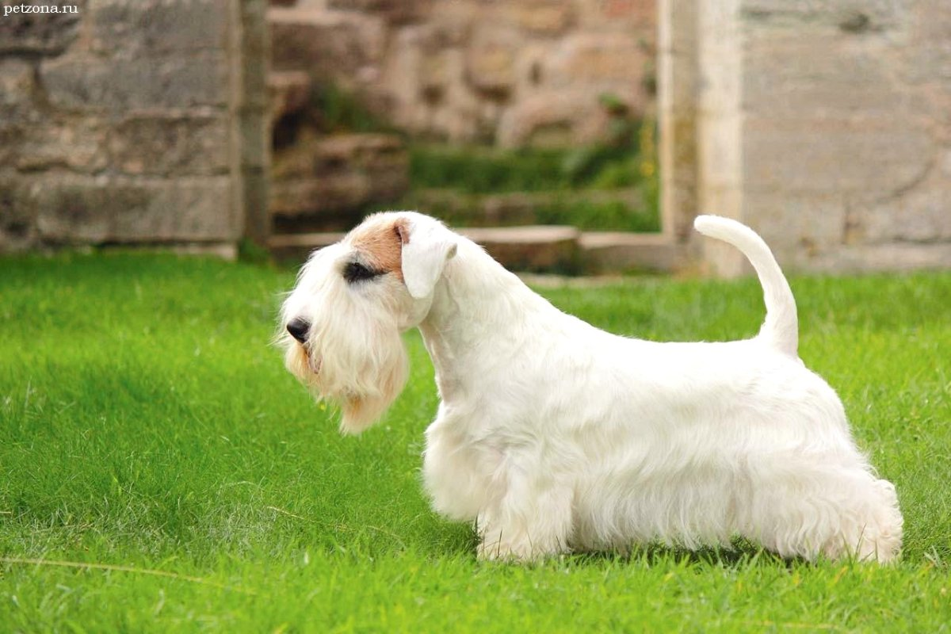
SEALYHAM TERRIER
Measures | Ideal
Height at the withers | Should not exceed 31 cm
Weight | Male 9 kg; female 8,2 kg
Standards | FCI – 074
Coat | Long, hard and wiry topcoat with weather-resistant undercoat.
Colour | All white or white with lemon, brown, blue or badger pied markings on head and ears.
Country of origin: GREAT BRITAIN
Free-moving, active, balanced and of great substance in small compass. General outline oblong, not square.
Sturdy, game and workmanlike. Alert and fearless but of friendly disposition.

Slide 31
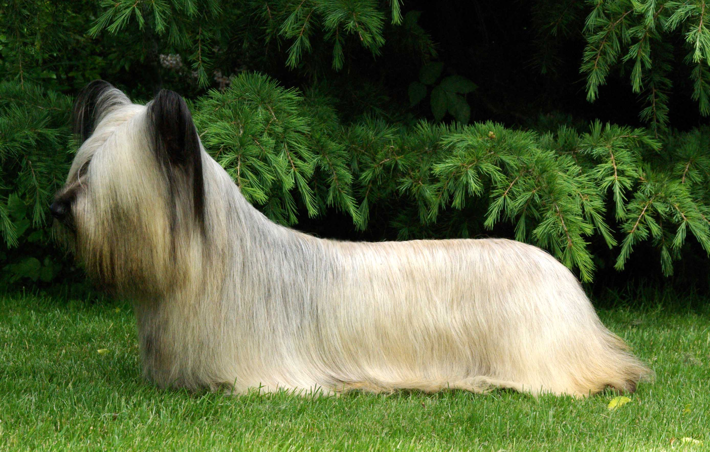
SKYE TERRIER
Measures | Ideal
Height at the withers | 25 - 26 cm. Females slightly smaller
Weight
Standards | FCI – 075
Coat | Double. Undercoat short, close, soft and woolly. Outer coat of reasonable length, hard, straight, flat and free from curl
Colour | Black, dark or light grey, fawn, cream, with black points.
Country of origin: GREAT BRITAIN
Long; twice as long as high, with coat of good length, Moves with seemingly effortless gait. Strong in quarters, body and jaw.
Elegant and dignified. A ‘one-man’ dog, distrustful of strangers, never vicious.

Slide 32
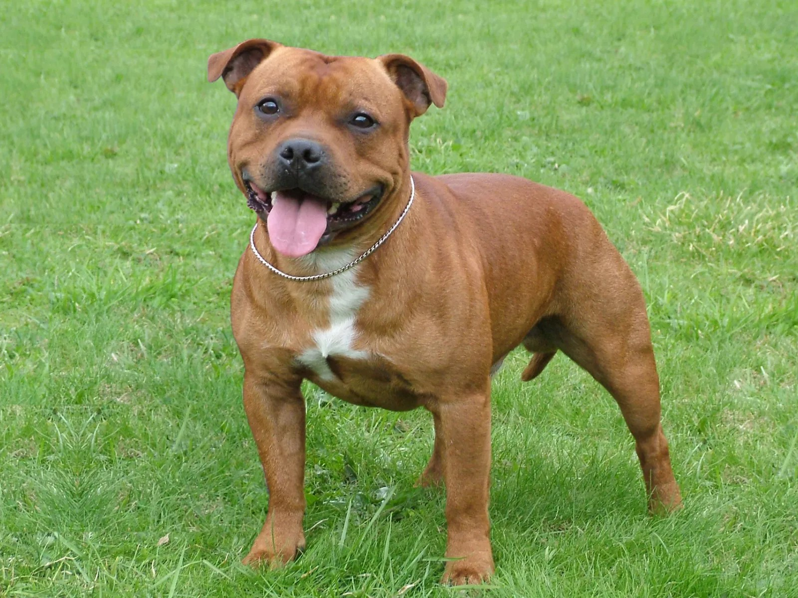
STAFFORDSHIRE BULL TERRIER
Measures | Ideal
Height at the withers | Between 35,5 cm and 40,5 cm
Weight | Male: 12,7-17 kg; female: 11-15,4 kg
Standards | FCI – 076
Coat | Smooth, short and close.
Colour | Red, fawn, white, black or blue, or any one of these colours with white.
Country of origin: GREAT BRITAIN
Smooth-coated, well balanced, of great strength for his size. Muscular, active and agile.
Traditionally of indomitable courage and tenacity. Highly intelligent and affectionate
especially with children. Bold, fearless and totally reliable.

Slide 33
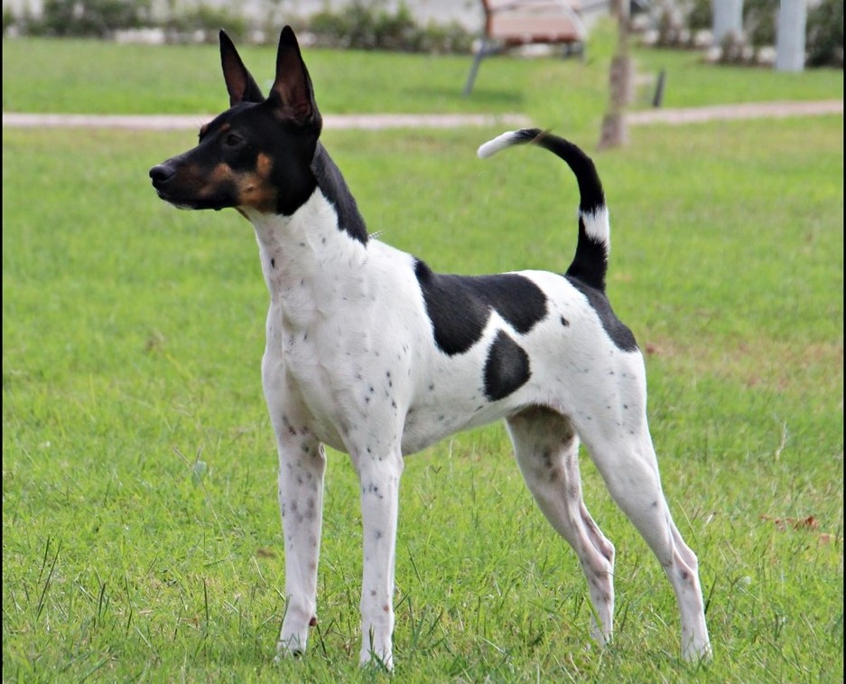
VALENCIAN TERRIER
Measures | Ideal
Height at the withers | Males: 30 to 40 cm, the ideal is 36 cm Females: 29 to 38 cm, the ideal is 33 cm
Weight | 4 to 8 kg
Standards | FCI – 370
Coat | Thin and short, no longer than 2 cm
Colour | Spotted coats dominate over the uniform ones. Among the spotted coats the most abundant is the tricolour (black-tan with white spots), followed by black-tan.
Country of origin: SPAIN
Small size, light and not extremely short, variable coat dominating tricolour.
Lively, happy and active. Affectionate and faithful, reserved with strangers. Brave, not only in hunting but also in the defence of his owners’ properties. Learns fast.

Slide 34
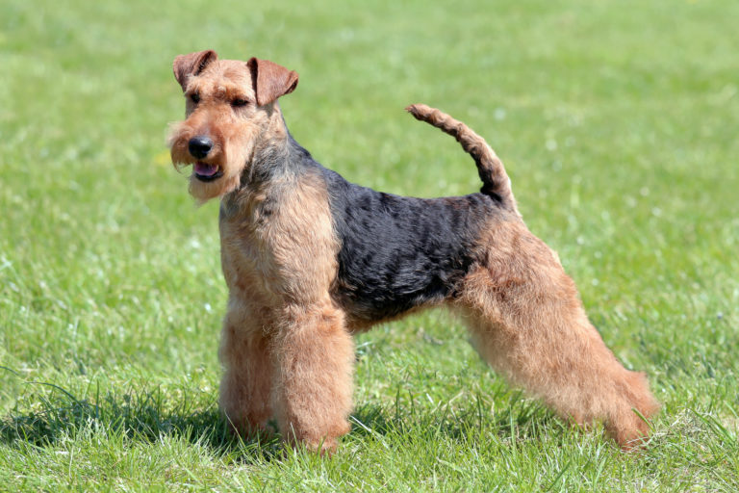
WELSH TERRIER
Measures | Ideal
Height at the withers | Not exceeding 39 cm
Weight | Between 9 and 9,5 kg
Standards | FCI – 078
Coat | Wiry, hard, very close and abundant. Single coat undesirable.
Colour | Black and tan for preference, or black grizzle and tan, free from black pencilling on toes.
Country of origin: GREAT BRITAIN
Smart, workmanlike, well-balanced and compact.
Affectionate, obedient and easily controlled. Happy and volatile, rarely of shy nature. Game and fearless but not aggressive although always able to hold his own when necessary.

Slide 35
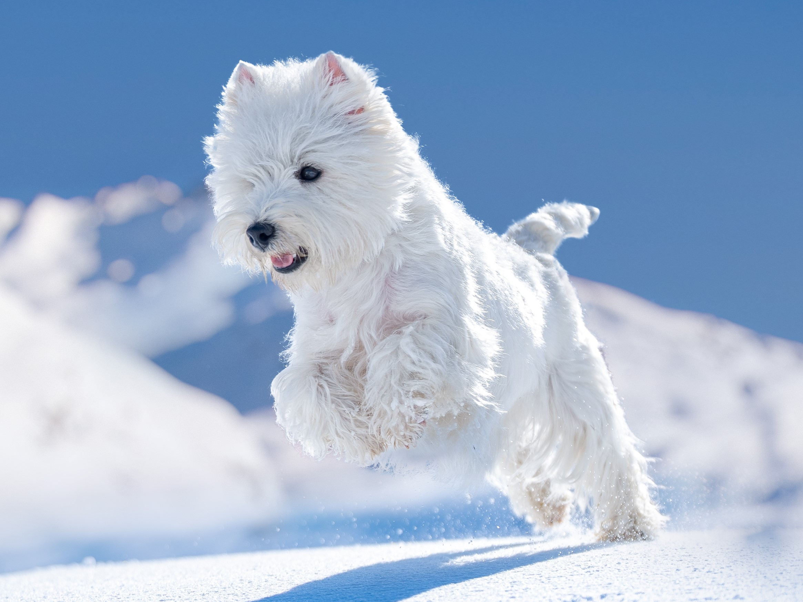
WEST HIGHLAND WHITE TERRIER
Measures | Ideal
Height at the withers | Approximately 28 cm
Weight
Standards | FCI – 085
Coat | Double coated. Outer coat consists of harsh hair, about 5 cm long, free from any curl.
Colour | White
Country of origin: GREAT BRITAIN
Strongly built; deep in chest and back ribs; level back and powerful quarters on muscular legs and exhibiting in a marked degree a great combination of strength and
activity.
Small, active, game, hardly, possessed of no small amount of self-esteem with a varminty appearance. Alert, gay, courageous, self-reliant but friendly.

Slide 36
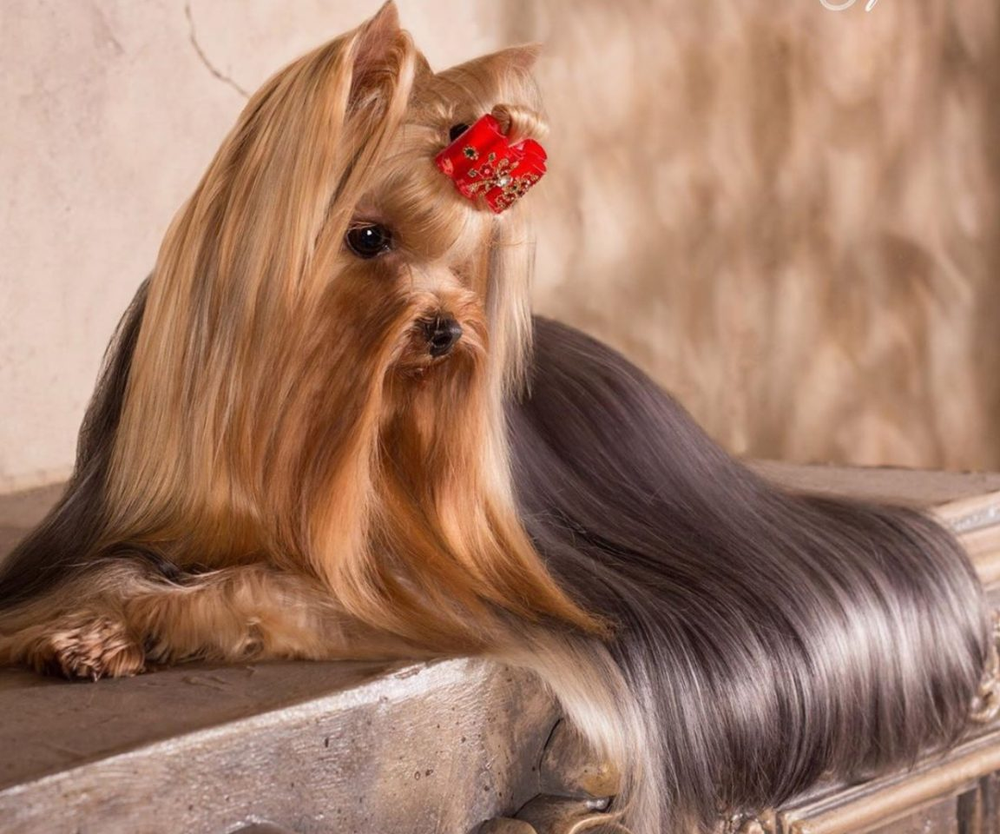
YORKSHIRE TERRIER
Measures | Ideal
Height at the withers
Weight | Up to 3,2 kg
Standards | FCI – 086
Coat | On body moderately long, perfectly straight (not wavy), glossy; fine silky texture, not woolly,
Colour | Dark steel blue, extending from occiput to root of tail, bronze or dark hairs. Hair on chest rich, bright tan.
Country of origin: GREAT BRITAIN
Long-coated, coat hanging quite straight and evenly down each side, a parting extending from nose to end of tail. Very compact and neat, carriage very upright conveying an important air.
Alert, intelligent toy terrier. Spirited with even disposition.

Slide 37
Presentation Terriers
Non FCI breeds 11 - nomenclature

Slide 38
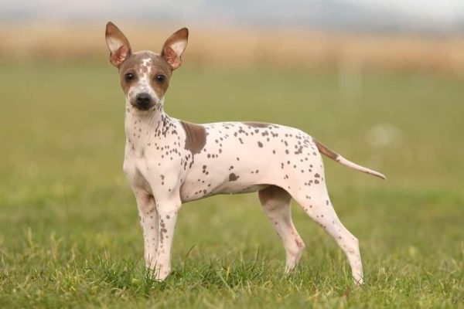
AMERICAN HAIRLESS TERRIER
Measures | Ideal
Height at the withers | Ideal height is from 30 cm to 40,5 cm
Weight
Standards | Non-FCI – 911
Coat | The breed is hairless but has a coated counterpart.
Colour | Any color or combination of colors is allowed with the exception of albino or merle.
Country of origin: U.S.A.
A small to medium sized, smoothly muscled and active terrier. They have retained a strong hunting instinct and excel in many other activities and sports.
The breed is energetic, alert, curious and intelligent. Given early socialization and training they excel as companions, displaying great affection for their owners and family.

Slide 39
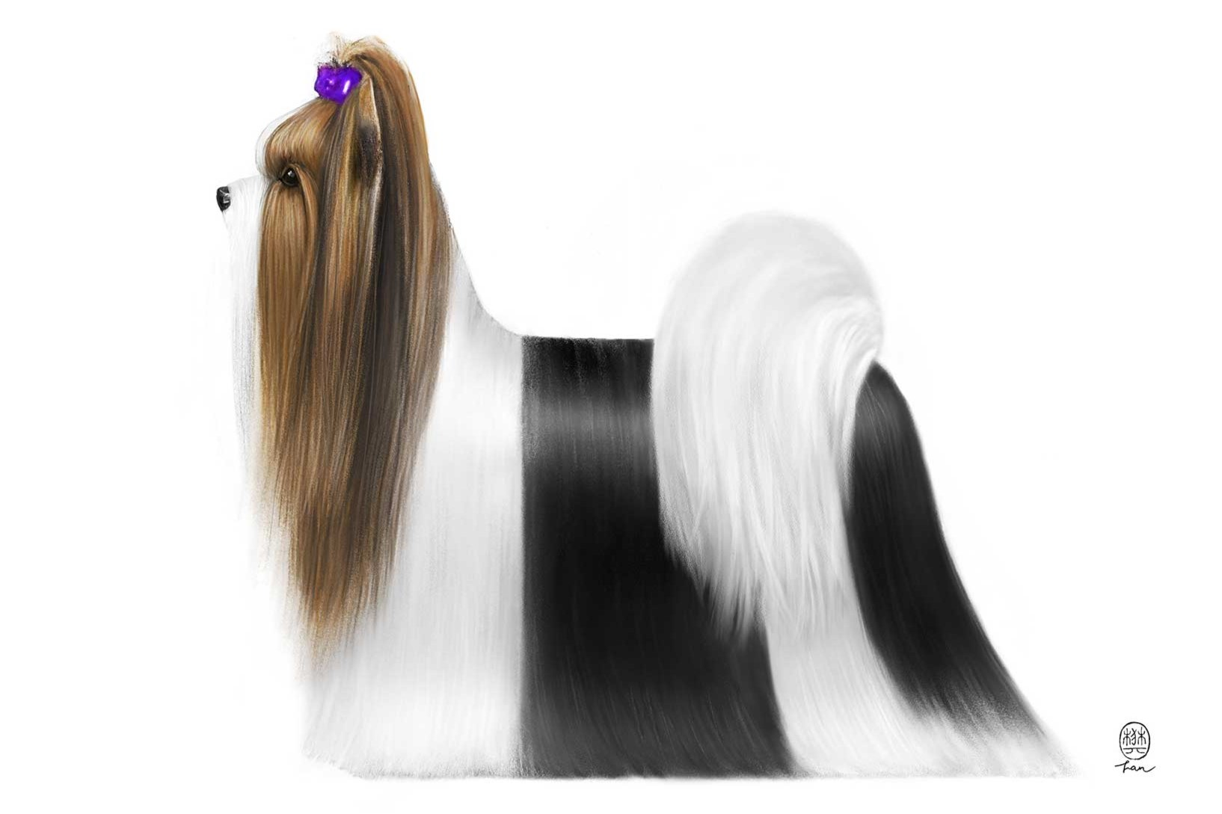
BIEWER TERRIER
Measures | Ideal
Height at the withers | Between 18 en 28 cm
Weight | Between 1,8 en 3,6 kg
Standards | Non-FCI – 904
Coat | Long and flowing with a soft silky texture. Hair is straight without an undercoat
Colour | Blue/Black, Gold/Tan, and White in good symmetry.
Country of origin: GERMANY
The Biewer Terrier is an elegant, longhaired, uniquely colored toy terrier with a breed signature ponytail.
Intelligent, loyal, and very devoted to their human family. They have a fun-loving, childlike attitude that makes them a great companion for all ages.

Slide 40
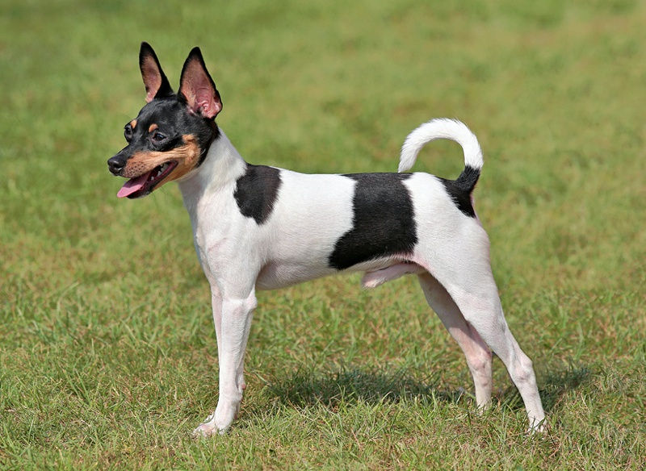
TOY FOX TERRIER
Measures | Ideal
Height at the withers
Weight
Standards | Non-FCI – 901
Coat | short, satiny and shiny, fine in texture and smooth to the touch
Colour | White is the predominating body color.
Country of origin: GREAT BRITAIN
Small in size, with a body that is square when viewed from the side. the appearance is elegant, balanced and aristocratic. Highly intelligent, alert, loyal, fearless and having much endurance.
Is self-possessed, spirited and determined. They are energetic, lively and strong for their size. They are friendly and loyal to their master or owners, yet protective.

Slide 41
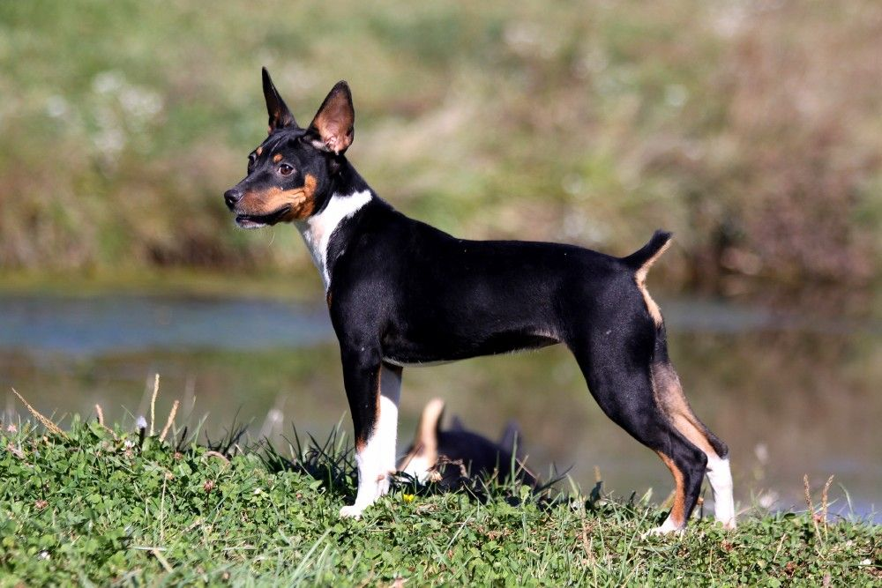
RAT TERRIER
Measures | Ideal
Miniature | Above 25,5 but not to exceed 33 cm
Standard | Above 33 but not to exceed 45,5 cm
Standards | Non-FCI – 937
Coat | Short, close lying, smooth and shiny coat.
Colour | Any variation of Pied patterning is acceptable
Country of origin: U.S.A.
The Rat Terrier is an intelligent, alert, well rounded, loving dog. They are very inquisitive and eager to please. This affectionate dog makes an excellent companion for those who will enjoy an energetic, but not hyperactive, dog.
They make good watchdogs. These dogs are quick, very playful and are not yappers.

